Slide 1
CHUBB Hong Kong
Walkthrough
Certify Workdone Process

Slide 2
Agenda
In/Out of Scope
New Process Flow – Overview
Key Changes
Walkthrough - From Certify Workdone To Post Invoice
SOX PTP06

Slide 3
Scope (In / Out)
In Scope
Order for Services (OS)
Email Workdone > JDE (Approval Matrix)
Automatic Email SubContactor
The first validation – AI Processor
The second validation - AP Officer (Full checking)
The third validation - AP Manager Approval the batch (Sample check, and invoiced amount more than US$10,000)
Out of Scope
OP, ON, OK, O9, ON and OT
Create new discount line
Match invoice without order
Revenue projection

Slide 4
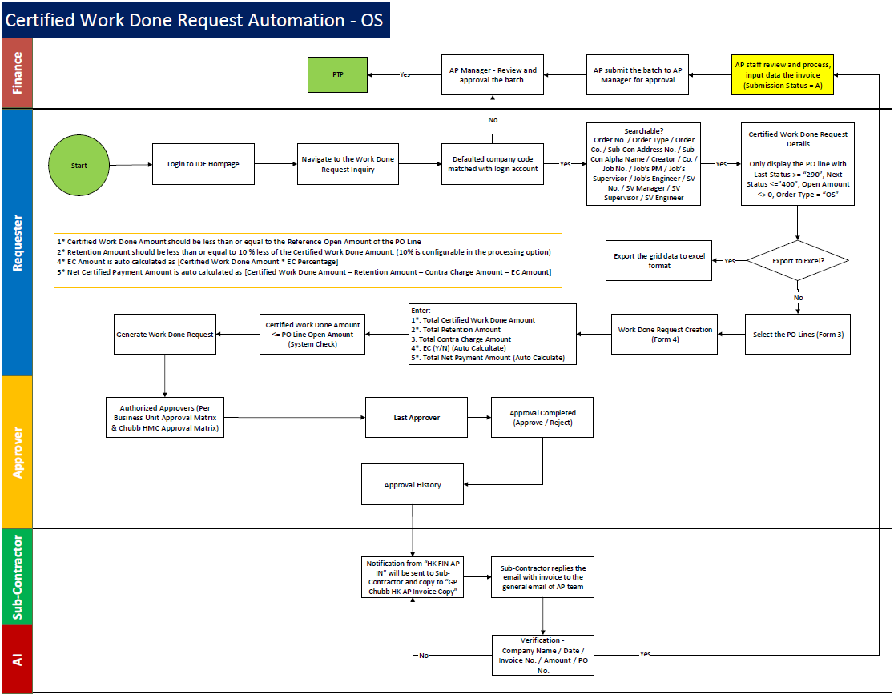
New Process Flow – Overview

Slide 5
Key Changes
Each Certificate of Work Completion must match one Invoice to one OS (One-to-One).
Approval of the Certificate of Work Completion should follow the original OC/NC approval routing.
Subcontractor invoice date cannot be earlier than the final approver's approval date.
Invoice amount cannot exceed the certified amount.
EC% is predefine and approved by the Branch GM.
Retention amount cannot exceed 10% of the certified amount
Contra Charge Debit Note should be ready before certification
For new project compliance with NEC4, the actual payment will be released 60 days after the last approver authorise the Certificate of Work Completion.
Finance team will not longer accept the paper invoices, or approvals outside of JDE.
SOX Control – PTP06 Three-Way Match is performed or Confirmation of goods receipt

Slide 6
Walkthrough - From Certify Workdone To Post Invoice

Slide 7
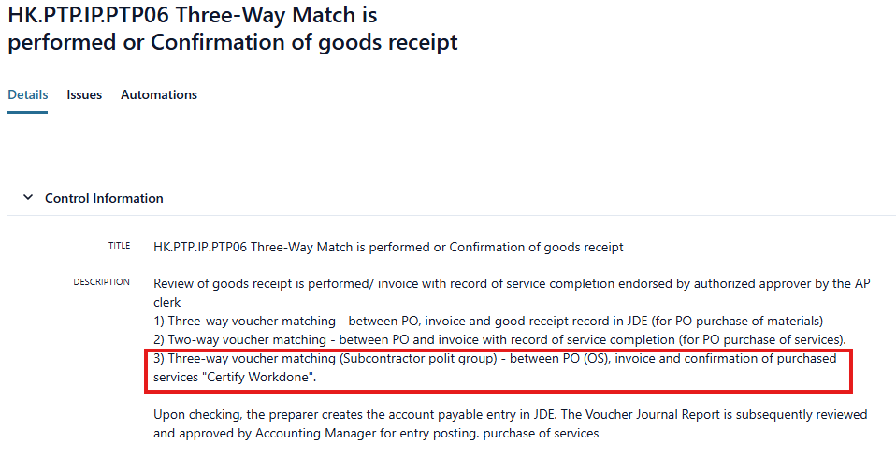
SOX – PTP06

Slide 8
Appendix

Slide 9
Supporting Documents

