Slide 1

JDE ENHANCEMENT
User Acceptance Testing
Certificate of Work Completion Automation

Slide 2
Agenda
In/Out of Scope
New Process Flow – Overview
New Process – Certify Workdone Request
Key Changes
Detailed Certification Process

Slide 3
In Scope
Sub-Contractors only (OC → OS)
Certificate of Work Completion Submission (JDE)
Certificate of Work Completion Approval + UBR (D1/D2) Approval (JDE)
Certificate of Work Completion email notification to Sub-contractor (JDE + Formscape)
Handle incoming invoice email (Power Automate + AI Builder)
Reject incompliance invoices
Gathering submitted invoices data to JDE (Power Automate)
Voucher Match process (JDE)

Slide 4
Out of Scope
OP, ON, OK, O9, ON and OT
Create new discount line
Match invoice without order
Revenue projection

Slide 5
New Process Flow - Overview

Slide 6
New Process Flow – Certify Workdone Request

Slide 7
Key Changes
Each Certificate of Work Completion must match one Invoice (One-to-One).
Approval of the Certificate of Work Completion should follow the original OC/NC approval routing.
For UBR Hold Approval
  D1 Hold can be released by the Project Manager.
  D2 Hold can be released by Jimmy after the Project Manager submits the request.
Subcontractor invoice date cannot be earlier than the final approver's approval date.
Invoice amount cannot exceed the certified amount
EC% is predefine and approved by the Branch GM
Retention amount cannot exceed 10% of the certified amount
Contra Charge Debit Note should be ready before certification
For new project compliance with NEC4, the actual payment will be released 60 days after the last approver authorise the Certificate of Work Completion.
Finance team will not longer accept the paper invoices, or approvals outside of JDE.

Slide 8
Certificate of Work Completion Process

Slide 9
Certify Workdone Process (High-Level)
Step by Step Process for Administrator
Checklist

Slide 10
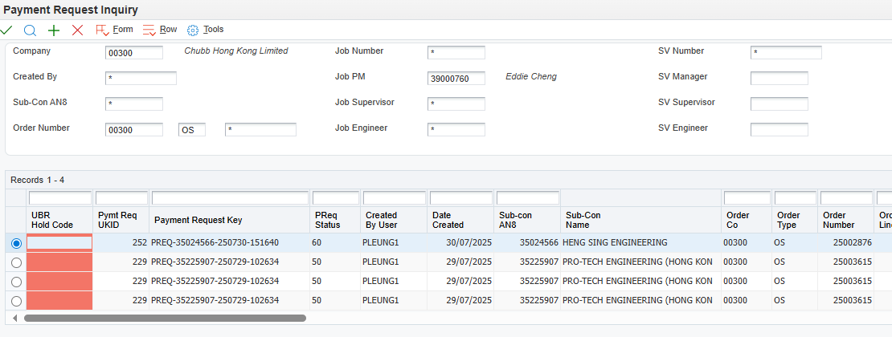
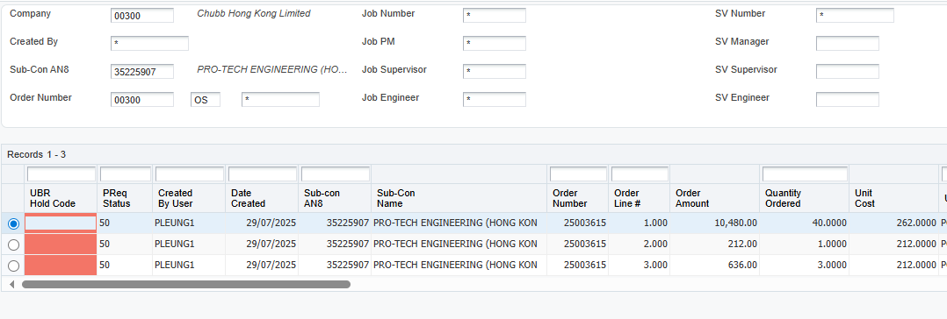
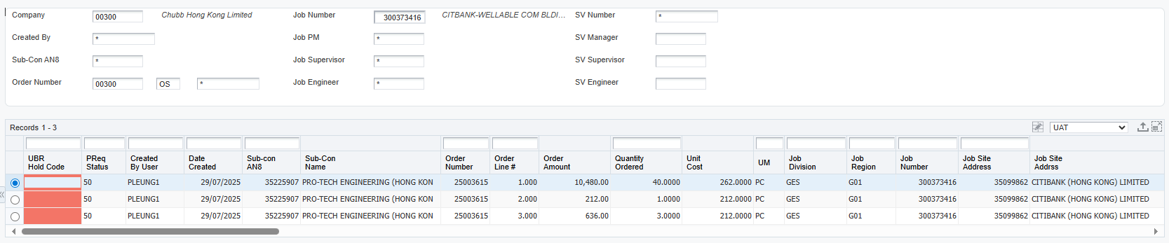
Generate Open OS
By Project Manager
By Job
By SubContractor
Export to Excel

Slide 11
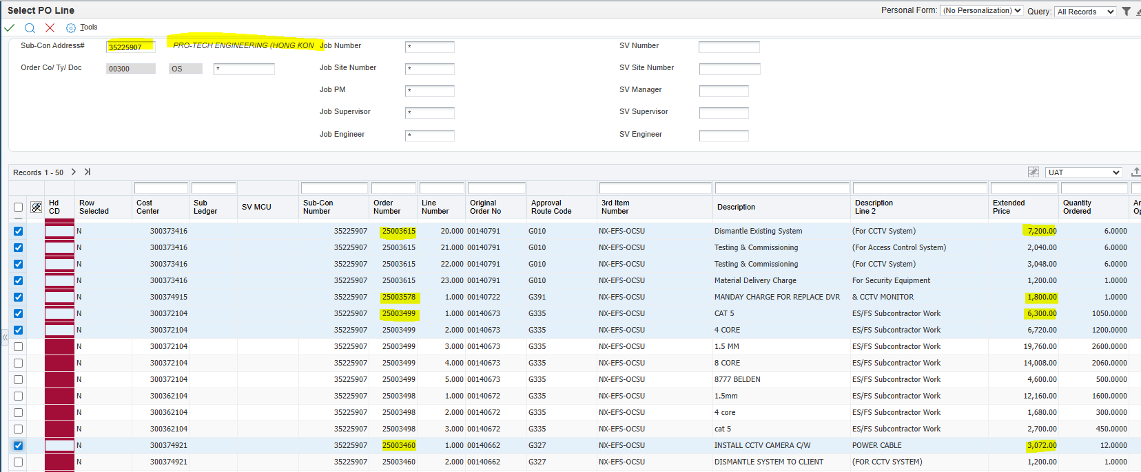
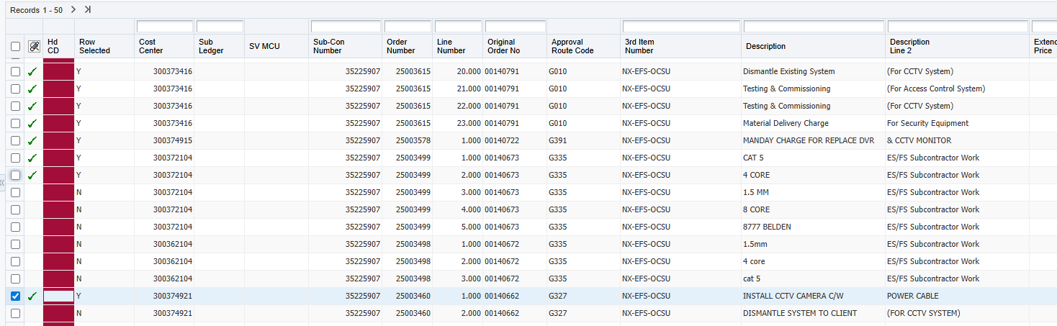
Certification of Work Completion Submission

Slide 12
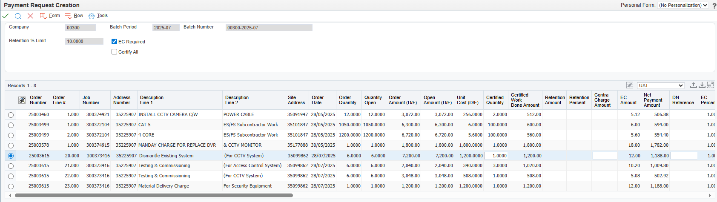
Certification of Work Completion Submission – Cont.

Slide 13
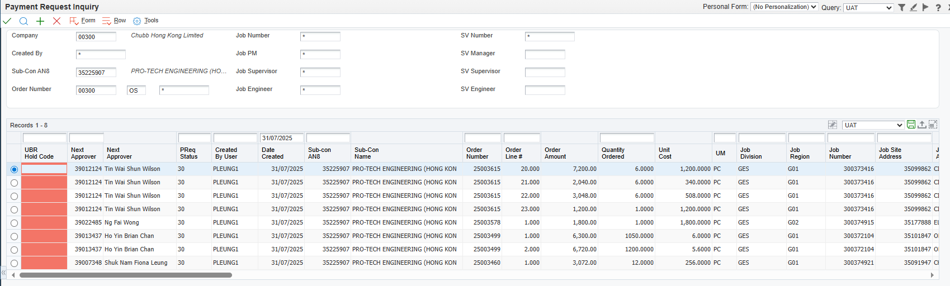
Certification of Work Completion Submission – Cont.

Slide 14
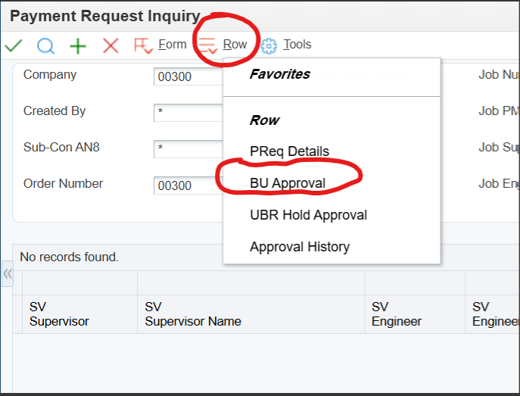
Certificate of Work Completion Approval

Slide 15
Certificate of Work Completion Approval
Goto “Payment Request Inquiry”
Select “Row” on the menu bar
Click “BU Approval”

Slide 16
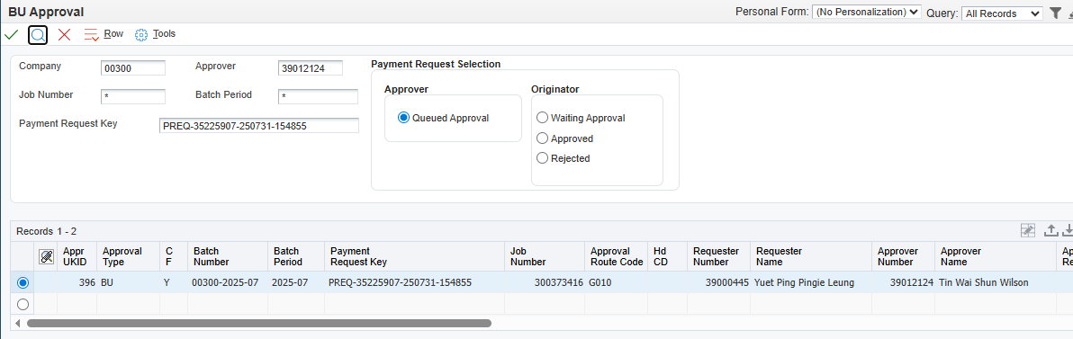
BU Approver and UBR (D1/D2) Approver

Slide 17
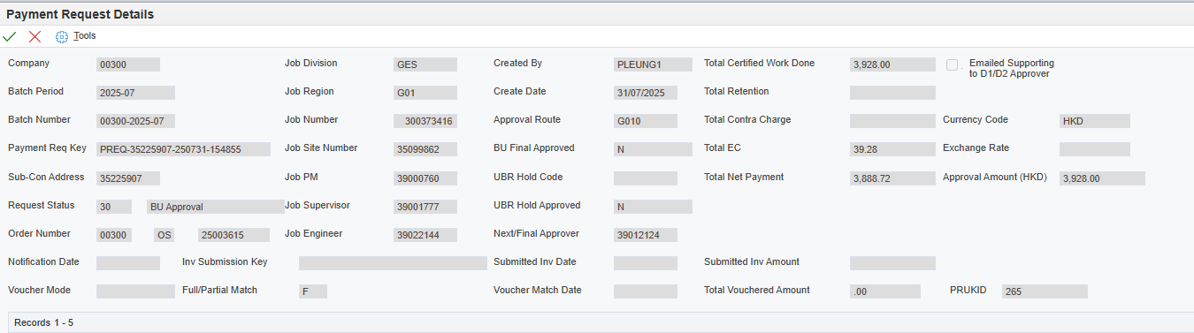
Before submit for D1/D2 hold

Slide 18
Payment Request email notification to Sub-contractor

Slide 19
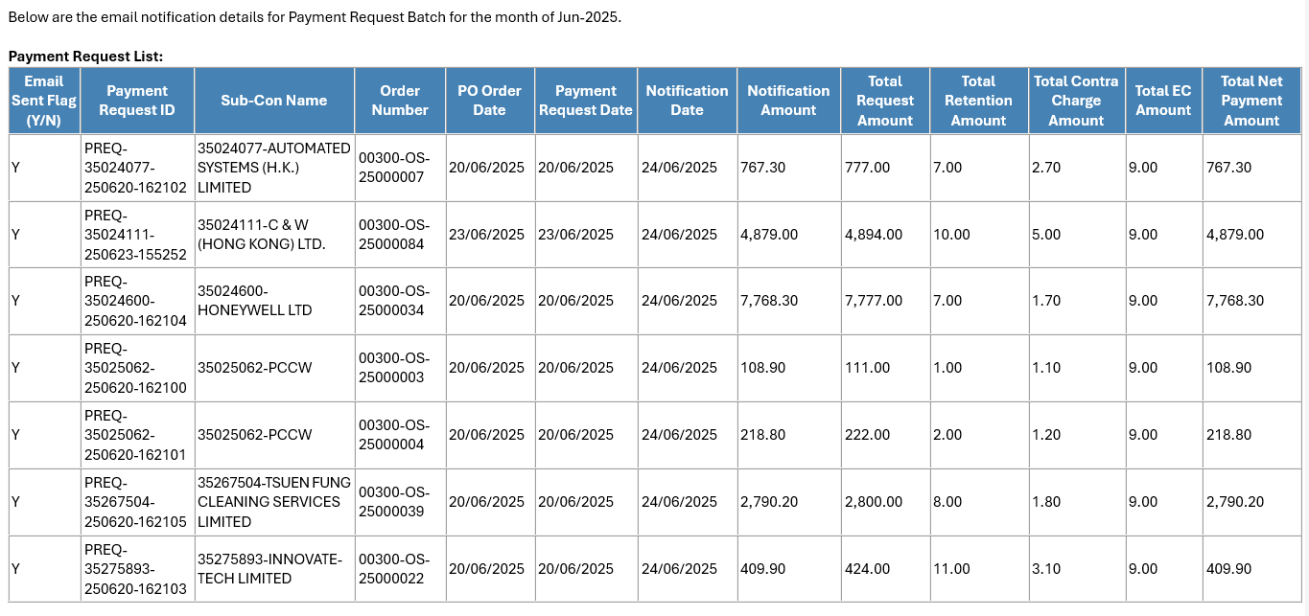
Monthly Summary Report

Slide 20
Accounts Payable Process
To Be Provided

Slide 21
Q & A

Slide 22
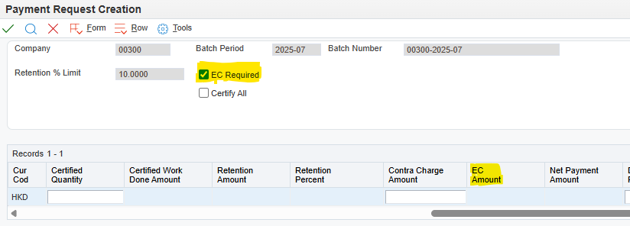
Appedix One – Employment Contribution %
BU | EC %
AA FS | 1
AA ES | 1
ACS ES | 1.27
ACS FS | 1.27
CHK ES | 1
CHK FS | 1.3
CSD ES | 1
CSD FS | 1
Easilink | 1
Monitoring | 1

Slide 23
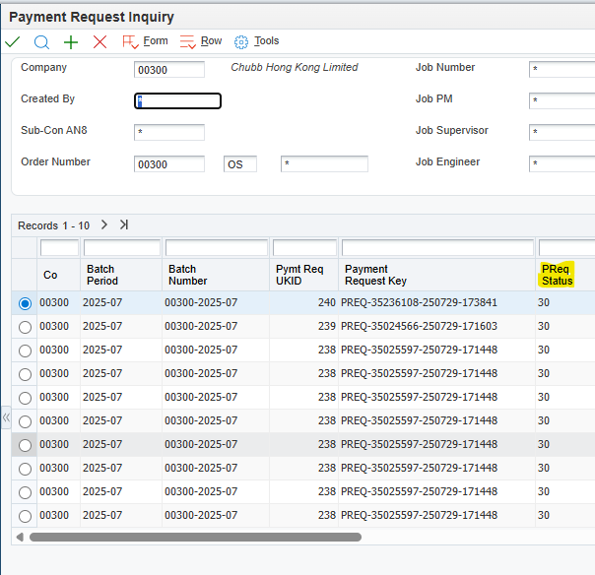
Appedix Two – Approval Flow Status
Payment Request Status | Status
30 | BU Approval
35 | UBR Hold
40 | UBR Approval
50 | Approval Completed
60 | Sub-con Notified
70 | Auto Voucher Match
80 | Manual Voucher Match
98 | Rejected

