Slide 1

Audit Walkthrough
Certify Workdone Process

Slide 2
Agenda
In/Out of Scope
New Process Flow – Overview
New Process – Certify Workdone Request
New Process – Invoice Input
Key Changes

Slide 3
Scopes (In / Out)
Order for Services (OS)
Email Workdone > JDE (Approval Matrix)
Automatic Email SubContactor
The first validation – AI Processor
The second validation - AP Officer (Full checking)
The third validation - AP Manager Approval the batch (Sample check, and invoiced amount more than US$10,000)

Slide 4
Out of Scope
OP, ON, OK, O9, ON and OT
Create new discount line
Match invoice without order
Revenue projection

Slide 5
New Process Flow - Overview

Slide 6
New Process Flow – Certify Workdone Request
Payment Request Automation Flowchart-v3 without UBR.pdf

Slide 7
Key Changes
Each Certificate of Work Completion must match one Invoice to one OS (One-to-One).
Approval of the Certificate of Work Completion should follow the original OC/NC approval routing.
Subcontractor invoice date cannot be earlier than the final approver's approval date.
Invoice amount cannot exceed the certified amount.
EC% is predefine and approved by the Branch GM.
Retention amount cannot exceed 10% of the certified amount
Contra Charge Debit Note should be ready before certification
For new project compliance with NEC4, the actual payment will be released 60 days after the last approver authorise the Certificate of Work Completion.
Finance team will not longer accept the paper invoices, or approvals outside of JDE.
SOX Control – PTP06 Three-Way Match is performed or Confirmation of goods receipt

Slide 8
Certify Workdone Process

Slide 9
Certify Workdone Process
https://chubbglobal.sharepoint.com/sites/FSCCFinanceMCHM/Shared%20Documents/FSCC%20Finance%20(MCHM)/Sharing%20Document/OS%20Project/Walk%20through_Sample/Walk%20through%20sample%20-%20OS25006198%20Auditors.xlsx?web=1

Slide 10
AP team – Invoice Input Process

Slide 11
Q & A

Slide 12
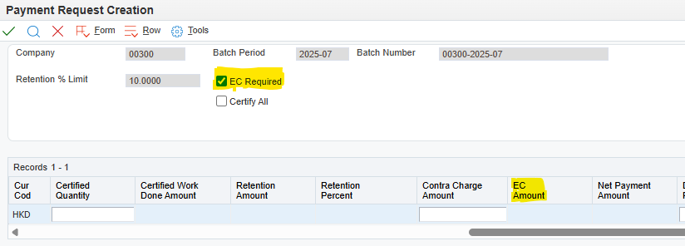
Appedix One – Employment Contribution %
BU | EC %
AA FS | 1
AA ES | 1
ACS ES | 1.27
ACS FS | 1.27
CHK ES | 1
CHK FS | 1.3
CSD ES | 1
CSD FS | 1
Easilink | 1
Monitoring | 1

Slide 13
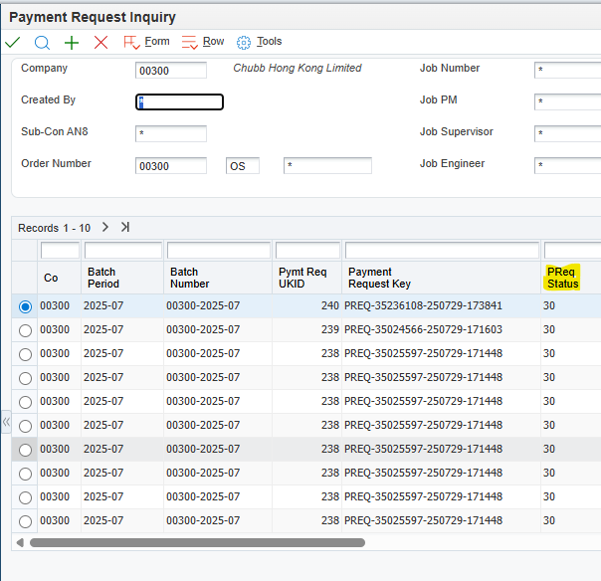
Appedix Two – Approval Flow Status
Payment Request Status | Status
30 | BU Approval
35 | UBR Hold
40 | UBR Approval
50 | Approval Completed
60 | Sub-con Notified
70 | Auto Voucher Match
80 | Manual Voucher Match
98 | Rejected

