Slide 1
Field service capability centre (fscc)
ANNIE CHEUNG
Jan 08, 2025

Slide 2
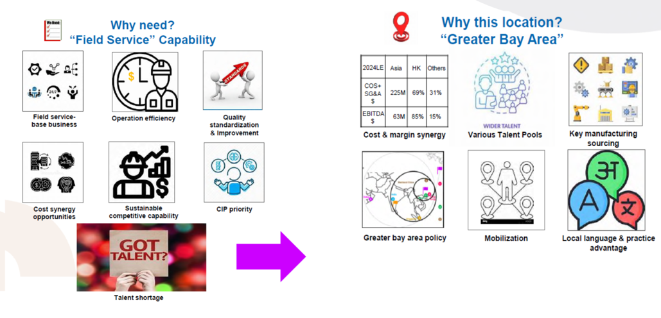
FSCC

Slide 3
Our VISION
Simplify
Standardize
Establish consistent procedures and protocols across all operations to ensure quality, reliability, and scalability.
Digitize
Streamline processes and eliminate unnecessary complexities to enhance efficiency and improve user experience.
Leverage technology to automate processes, enhance data accessibility and drive innovation in service delivery.
MCHM

Slide 4


Business objectives

Slide 5
Objectives
Enhance Operational Efficiency
Increase BU (Customer) Satisfaction
Establish Standardized
Streamline processes to reduce response times and improve service delivery
High-quality service and address BU needs promptly
Develop consistent protocols and workflows to ensure uniformity across MCHM
Enhance Collaboration
Promote team across departments and MCHM to improve service coordination

Slide 6
Roles and responsibility

Slide 7
Responsibility
  Understand and document the current processes and its pain points
  Simplify and standardize the processes together as a team, before digitalize
  Communicate the rationale of changes to branch leaders and their teams
  Work with local management and team members to adapt the changes
  Ensure the new process is compliance
  Commit to the agreed deadlines and readiness for changes
  MCHM group
  prepare project justification and prioritize the requests
  Review the effectiveness of the new process after implemented
  Process owners
  Respective processes in location branch.
  Escalate to corresponding team leads when necessary

Slide 8
Key tasks
Project Brief
State the current process and workflow preparation
Provide project justification and prioritization
Business Case
FitGap Analyst
Business requirements and new/reestablish process designs
Project Implementation Plan
UAT
Document the new process flow and manage the transition to new processes with end users

Slide 9
Key dates

Slide 10
Key dates
Items | Status | By who? | By when?
Nominate process owners (5 Capabilities) and its team members | Done | Simon L, Kevin L, Jimmy T, Cindy C, Ken C | 16th Dec
Kickoff meeting - Brief the scope and approach | Done | Process owners and team members, Matthew L | 2nd Jan
Register your processes in Master Project List Provide details current processes Prepare potential standardized process flow for MCHM | Open | Process owners | 28th Jan
Discuss digitalized solution for your projects by interviewing with 5 capabilities team individually or group | Open | Process owners, IT and vendor | Mid of Jan to mid Feb
Prepare the scope for 1st phase and also the 1st draft of project plan with lead time and cost and priority | Open | Process owners, IT and vendor | End of Feb
Review with Steering Committee and gain project approval | Open | Project Steering Committee, Process Owners and IT | Early of Mar

Slide 11
What’s next
Understanding the pain points
Document the current process flow and highlight the key compliance steps
Identify the improvement areas
Assign the process owner

Slide 12

Next meeting (weekly)
The 1st draft
Business brief
Wednesday,
January 15, 2025

Slide 13
Examples
What process spent more time on
Is the process within our control
Why making the changes
What benefit will be generated after implement the changes
What can improve the turnaround time to business
More transparent and operational efficiency
Improve the control deficiency
    Simply and standardize financial processes to reduce redundancy and enhance workflow efficiency
    Enhance Data Accuracy

