Slide 1
Field service capability centre (fscc)
ANNIE CHEUNG
April 02, 2025

Slide 2
Name changes
This project has been renamed from FSCC to CCC
CCC = China Capability Centre

Slide 3
Our VISION
Simplify
Standardize
Establish consistent procedures and protocols across all operations to ensure quality, reliability, and scalability.
Digitize
Streamline processes and eliminate unnecessary complexities to enhance efficiency and improve user experience.
Leverage technology to automate processes, enhance data accessibility and drive innovation in service delivery.
MCHM

Slide 4
Key tasks
Project Brief
[Completed]State the current process and workflow preparation
[Completed]Provide project justification and prioritization
Business Case
FitGap Analyst
Business requirements and new/reestablish process designs
Project Implementation Plan
UAT
Document the new process flow and manage the transition to new processes with end users

Slide 5
Process list

Slide 6
Processes Description​ | Benefits​ | Priority​ | Budget (HKD)​ / Lead time (months)​ | Status​ | Proposed IT Solutions​ | Phase​
AP Supplier Payment Process (incl. Payment Approval, E-invoices)​ | Develop a streamlined process for managing supplier invoices, including issue resolution, approval, reducing delays and errors.​ Reduces paper usage and speeds up invoice processing.​ Standardize the process MCHM​ Improve the tracking of supplier transactions through an online Approval.​ Paperless, and more easy access ​ | 1​ | HKD $140K for Part 1​ ​ TBC for part 2 (funded by APi)​ ​ | Requirement Study for Part 1​ ​ / ​ ​ Arrange demo on Aug for Part 2​ | Part 1 for OS – Subcon PO: Develop a new module in JDE called "Payment Request"​ For the Job's PM/ service manager to select OS order for Payment Request creation. (Add the UBR hold code to check before create the Payment Request)​ Approve the Payment Request (Approval matrix is to be discussed)​ Send notification to vendor.​ Receive email from supplier (with Payment Request ID) to store the supplier invoices in the Sharepoint Online​ Automatic generate Payment Voucher (PV) in Hold(H) status based on the Payment Request information.​ Finance AP team to change their status from Hold (H) to Approved (A) when approve the payment. ​ ​ Part 2 for OK, OX and OP: Develop an online workflow in GEP AP module​ | 1 For Part 1​ ​ /​ ​ Next phase for Part 2​ ​
AR Settlement​ | Implement the Global solution AR Settlement from Blackline in order to automate the AR settlement process​ ​ | 1​ | TBC ​ | Arrange demo on Apr​ | ​ | 1​

Slide 7
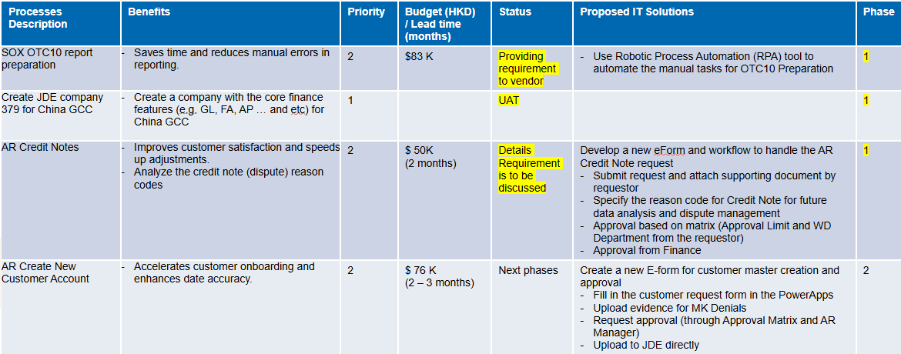

Slide 8
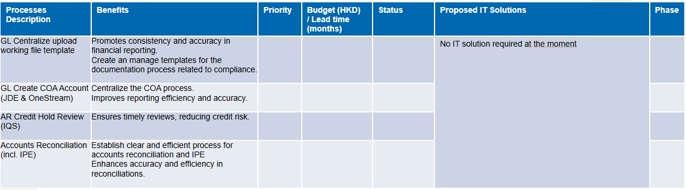

Slide 9
AreaS
MCHM
Upload working file template
COA (JDE & OneStream)
E-Invoice - GEP
E-Approval - GEP
Payment Process (include Approval) - GEP
Create New Customer Account – Ph2
Credit Hold Review - TBC
Scan document to attachment in JDE
Late PO alert - GEP
Local Office(s)
Format of Statement of Account
Cheque Register
Official Receipt
Change the envelope cutting
Service Contract Register
Others
Accounts Reconciliation
OTC10 report preparation
Settlement AR
Credit Notes

Slide 10

Next meeting (weekly)
FitGap Analyst
Wednesday,
April 23, 2025

