Slide 1
Digitalization for
Field service capability centre (fscc)

Slide 2
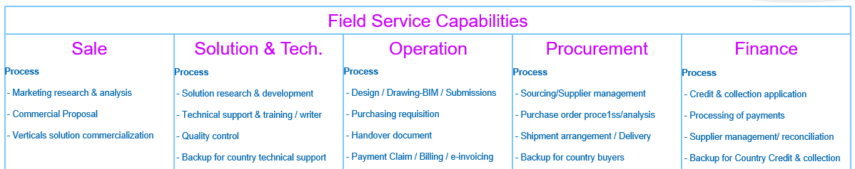
Overview
Collaborate different processes with different teams in different locations
Office Setup: Network & Infrastructure
SDWAN
Cloud
Zscaler
Servers on premise
File Sharing
SharePoint Online
File server
Process Automation
PowerApps
PowerAutomate
AI Builder
RPA
Global Applications
SideTrade
GEP – AP Automation
Global CRM
Enhance Applications
JDE
IQS
Power BI

Slide 3




Goals
Simplify current processes
Standardize processes across MCHM
Digitalize
$
Operation efficiency
Quality standardization & Improvement
Sustainable competitive capability
CIP priority

Slide 4
Keys to success
Processes
Technologies
Internal resources
External vendor
Program (Projects) Fundings

Slide 5








Technologies
Enhancing existing applications
New Global Target Applications
Process Automation tools

Slide 6








Technologies – Global target application architecture
Oracle CX
Service
Oracle CX
Service
CPQ
QEHS
Customer Portal
2025
Customer Service
Field Service Management
CRM
2025
to 2026
Sales
Project Operations
DATAHUB
Data Integrations,
Analytics & Master Data
Procurement –
Source to Contract
Order to Cash
2025 to
2026
Travel &
Expense
Core
Financials
Procure to Pay
Kronos
HCM
Payroll & Timesheets
2025
to 2026

Slide 7
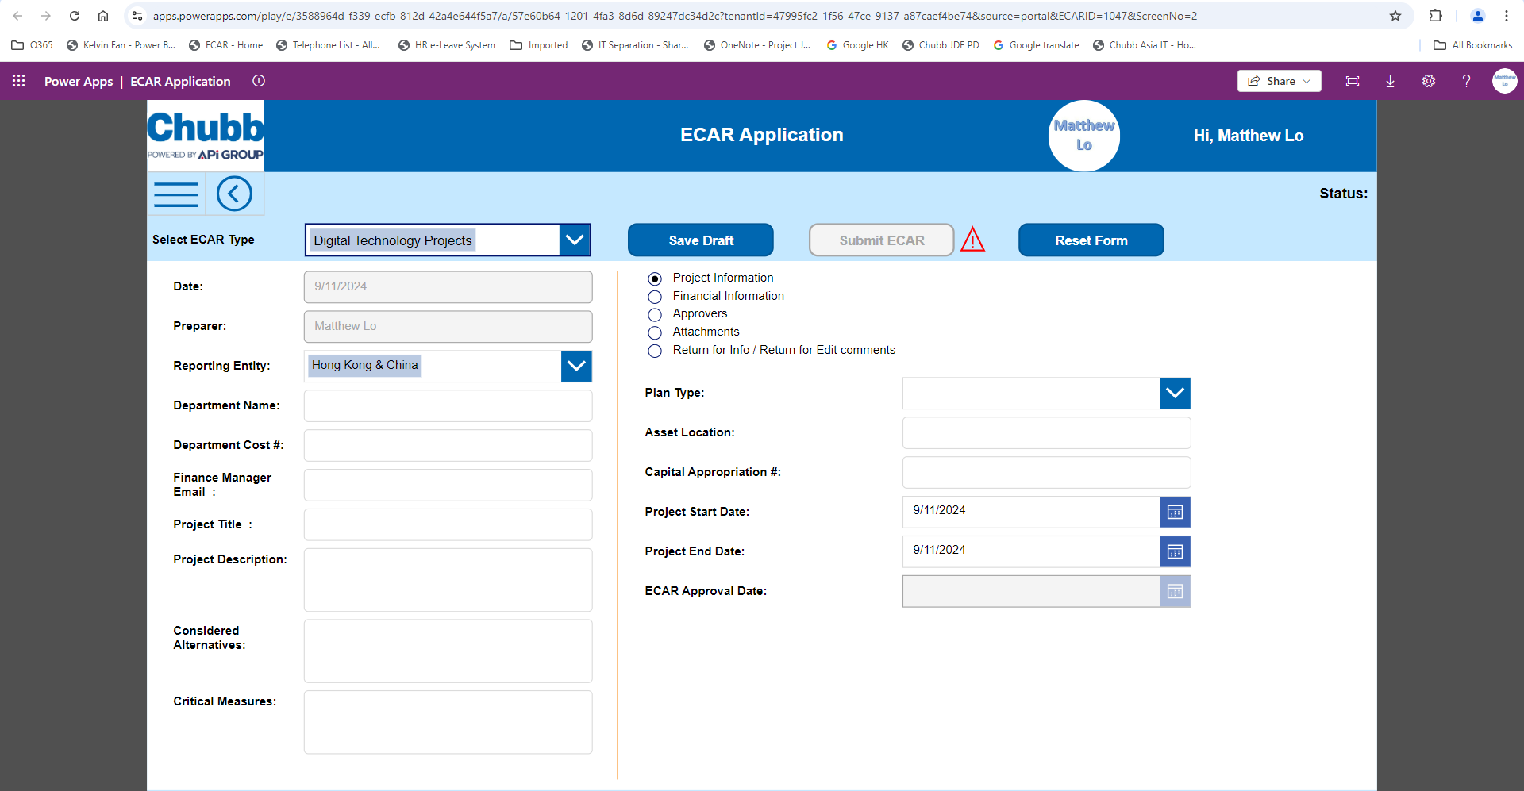
Technologies – Process Automation Tools
  Microsoft PowerApps
  Deliver web and mobile apps (E-form) with low codes and quicker deployment

Slide 8
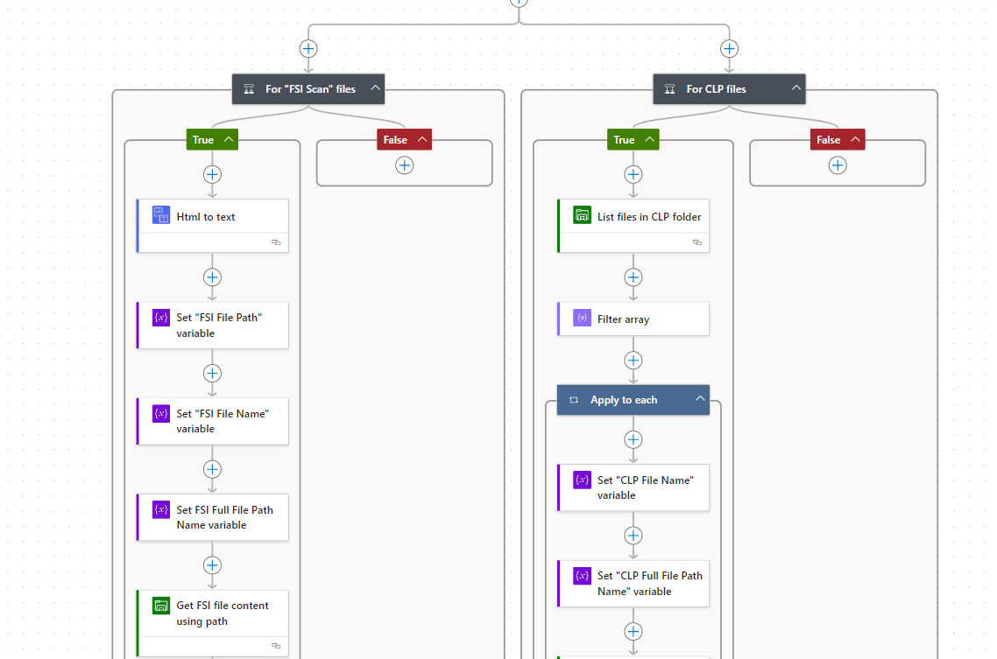
Technologies – Process Automation Tools
  Microsoft PowerAutomate
  A comprehensive, end-to-end cloud based process automation (Workflow) platform powered by low code and AI.

Slide 9
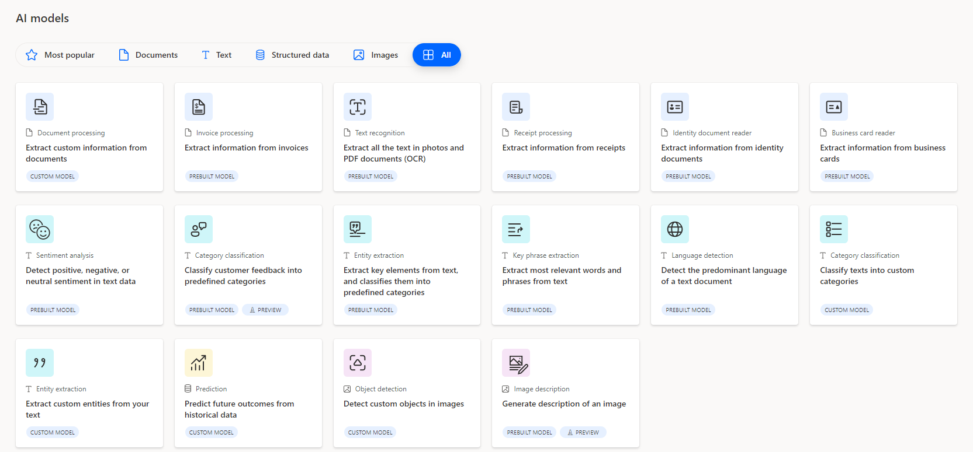
Technologies – Process Automation Tools
  Microsoft AI Builder
  Integrate AI capability with PowerApps and PowerAutomate including:
  Document Intelligent
  Entity extraction
  Sentiment analysis
  Data prediction
  Object detection
  GPT integration
  … and etc

Slide 10

Technologies – Process Automation Tools
  Robotic Process Automation (RPA) is a technology that uses software robots, or “bots,” to automate repetitive and rule-based tasks typically performed by humans. These tasks can include data entry (clicking, typing, copying and pasting), form filling, moving files and moving data between business applications and your data source (PDF, Excel files)

Slide 11
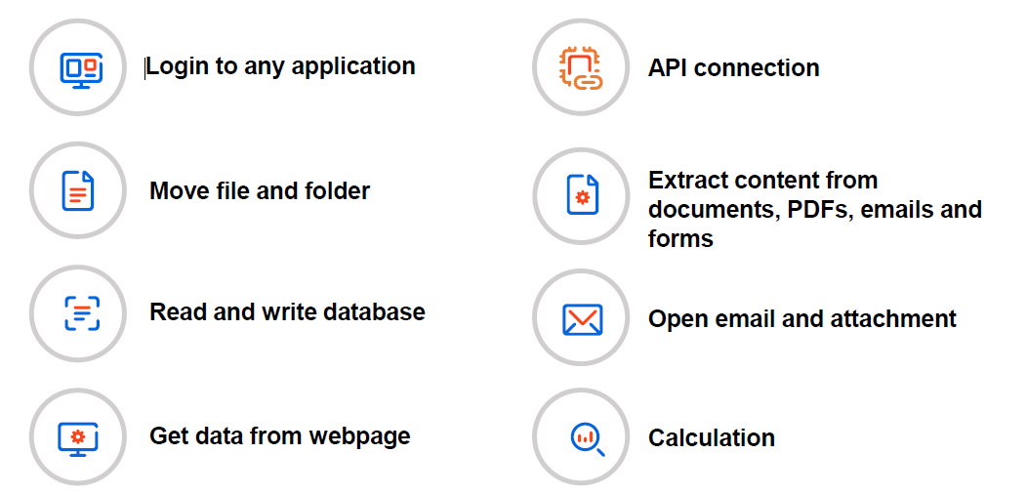
Technologies – Process Automation Tools
  Robotic Process Automation (RPA)
  What tasks RPA robot can easily accomplish ?
  What are the example of tasks automation in Chubb?
  - E.g. IPE data extraction automation

Slide 12
Project team – Org chart
Project Steering Committee
KT, Yiu | Vice President, Asia Pacific |  | Samantha Tam | HR, Asia |  | Simon Lo | Sales, Asia
Pele Wong | MD, FS & CMS MCHM |  | Ken, Chiu | CFO, Asia |  | Cindy Yuen | SCP, HM
Stephen Au Yeung | MD, ES MCHM |  | Matthew, Lo | IT, Asia |  | Jimmy Tan | Ops, MCHM
 |  |  |  |  |  | Kevin Lam | Solution, MCHM
Program Manager
Matthew Lo | IT, Asia
External vendor
Bcplus + TBC
IT
Sales
Finance
Operation
Project Lead
Process Owner
Process Owner
Process Owner
 | To be nominated
Gene Ho | Sales, HK ES
Annie Cheung | FC, HK
Jimmy Tan | Operation, MCHM
Team Members
Team Members
Team Members
Team Members
 | To be nominated
 | To be nominated
Ming Lau | FD, HK
Mona Lok | FM, MO
Amy Shi | FM, CN
Eric Wu | FP&A, Asia
Ron Lung | FS Ops, HK
Fiona Leung | ES Ops, HK
Annie Kwong | ES Service, HK
Qingfeng Xi | ES Ops, CN
Mars Chen | ES Service, CN
Solution
Procurement
Process Owner
Process Owner
Kevin Lam | Solution Manager MCHM
Cindy Yuen | Supply Chain, HM
Team Members
Team Members
Raymond Yau | Solution Eng. MCHM
 | To be nominated

Slide 13
Roles and responsibility
Process Owners
Responsibility:
Engaged as the owners the respective processes in MCHM
Understand and document the current processes and its pain points
Simplify and standardize the processes before digitalize
Prepare project justification and prioritize the requests
Communicate the rationale of changes to branch leaders and their teams.
Work with local management and team members to adapt new systems with business processes
Ensure the new process is compliance
Escalate to corresponding team leads when necessary
Review the effectiveness of the new process after implemented
Manage team members to perform the deliver below key tasks
Key tasks:
Current process flow preparation
Provide and confirm business requirements and new solution designs
Provide project justification and prioritization
Conduct UAT
Document the new process flow and manage the transition to new processes with end users
IT
Responsibility:
Prepare master project plan in detail with external vendors and process owners
Select the appropriate digital tools and platforms that align with your objectives
Work with vendor to propose the solution with project ballpark and estimated lead time
Ensure the new process is compliance and meet with Global Cyber and IT requirements
Project requests prioritization
Assist to gain approval on project fundings
Manage the project implementation activities
Track the project and report on the progress to Project Steering Committee and project stakeholders
Key tasks:
Functional and technical spec preparation
Propose technologies and solutions
Vendor management
Manage and track the project activities progress
SIT
Work with project team members to perform different project activities
Technical environment setup and readiness

Slide 14
Implementation Cycle by phases
1. Assessment and Gap Analysis
2. Project Justification and Prioritization
Next Phase
3. Project Funding Approval
4. Projects Implementation
5. Change Management
6. Monitoring and Optimization

Slide 15
Implementation details approach
1. Assessment and Gap Analysis
Identify Processes: List out all business processes will be simplified and centralized in FSCC
Analyze Current State: Map out the current processes to understand inefficiencies and bottlenecks
1.1 Process Simplification
Create Process Flow: Create detailed flowcharts or diagrams to visualize each step of the current processes.
Eliminate Redundancies:
  Analyze Steps: Identify and remove unnecessary steps that do not add value
  Streamline Workflows: Combine or rearrange steps to make the process more efficient.
Focus on Core Activities:
  Prioritize Tasks: Focus on activities that directly contribute to business goals.
  Reduce Complexity: Simplify decision-making points (e.g. approval matrix) and reduce the number of approvals required.
1.2 Process Standardization
Process variations:
  Identify the process variation across MCHM and look for standardization opportunities.
Define Standards:
  Establish clear, concise, and achievable standards for each step of the process
Develop Standard Operating Procedures (SOPs):
  Create detailed SOPs that outline the standardized process. These should be easy to understand and follow.
1.3 Process Digitalization
Set Clear Objectives: Define what you aim to achieve with digitalization, such as reducing manual work, improving data accuracy, or enhancing collaboration experience.
Choose the Right Technology: Select the appropriate digital tools and platforms that align with your objectives. This could include software for automation, data analytics, or cloud storage.
Design the Digitalized Process: Map out the new digitalized process, incorporating the chosen technology.

Slide 16
Implementation approach
2. Project Justification and Prioritization
Benefit (Tangible / Intangible):
  Goals for what the improvement or automation should achieve (e.g., reduce processing time, improve accuracy, reducing manual work, improving data accuracy, or enhancing collaboration experience).
Estimated Project Lead time
Project ballpark
Internal resources availabilities
3. Project Funding Approval
Approval granted by Steering Committee
5. Change Management
Change Management:
Manage the transition to new processes to minimize disruption and ensure buy-in from all stakeholders
Employee Training:
Ensure that employees are trained on the new processes and tools.
4. Projects Implementation
Run projects individually
6. Monitoring and Optimization
Continuous Monitoring:
Regularly monitor the performance of the new processes to ensure they are meeting the set objectives.
Continuous Improvement:
Make ongoing adjustments and improvements based on feedback and performance data

Slide 17
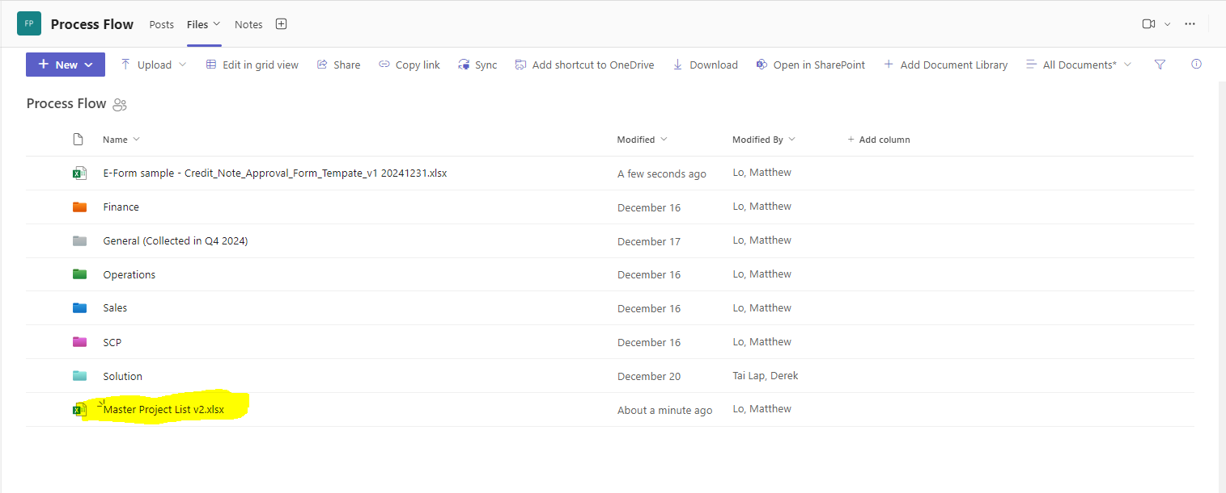
Master Process List – Phase 1
- Register your process in the master list
Path: Process Flow

Slide 18
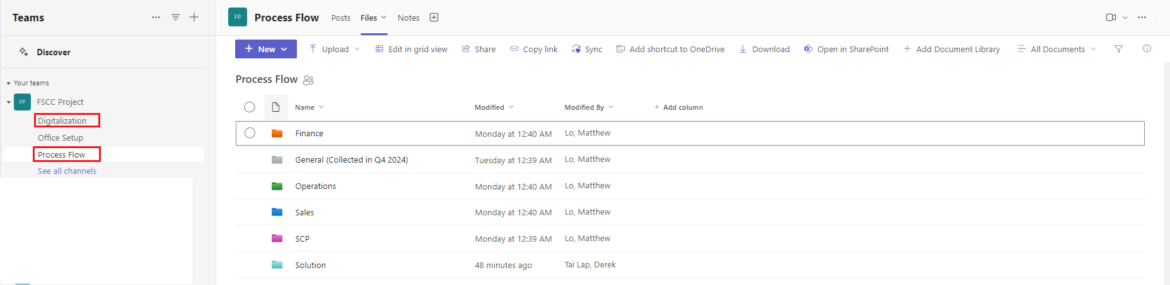
Details Process
Reference the process flows of SCP
Also, the general flows from previous files
Path: Process Flow

Slide 19
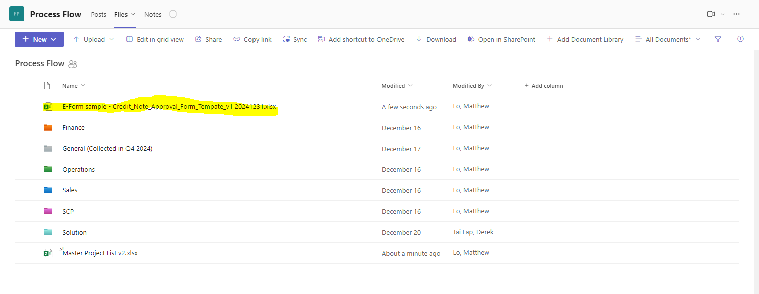
E-Form template
Reference the Credit Note Approval Form
Path: Process Flow

Slide 20
What’s next?
Items | Status | By who? | By when?
Nominate process owners (5 Capabilities) and its team members | Done | Simon L, Kevin L, Jimmy T, Cindy C, Ken C | 16th Dec
Kickoff meeting - Brief the scope and approach | Done | Process owners and team members, Matthew L | 2nd Jan
Register your processes in Master Project List Provide details current processes Prepare potential standardized process flow for MCHM | Open | Process owners | 28th Jan
Discuss digitalized solution for your projects by interviewing with 5 capabilities team individually or group | Open | Process owners, IT and vendor | Mid of Jan to mid Feb
Prepare the scope for 1st phase and also the 1st draft of project plan with lead time and cost and priority | Open | Process owners, IT and vendor | End of Feb
Review with Steering Committee and gain project approval | Open | Project Steering Committee, Process Owners and IT | Early of Mar

Slide 21
END

Slide 22
BACKUP SLIDE

