Slide 1
Standardize the upload working file
Prepare date: Aug 2025
Preparer: Carrie Lam

Slide 2
Monthly upload files in Onestream system
We have 3 files need to upload in onestream system
JDE trial balance
USGAAP XFD.xlsx
Supplemental XFD.xlsx

Slide 3
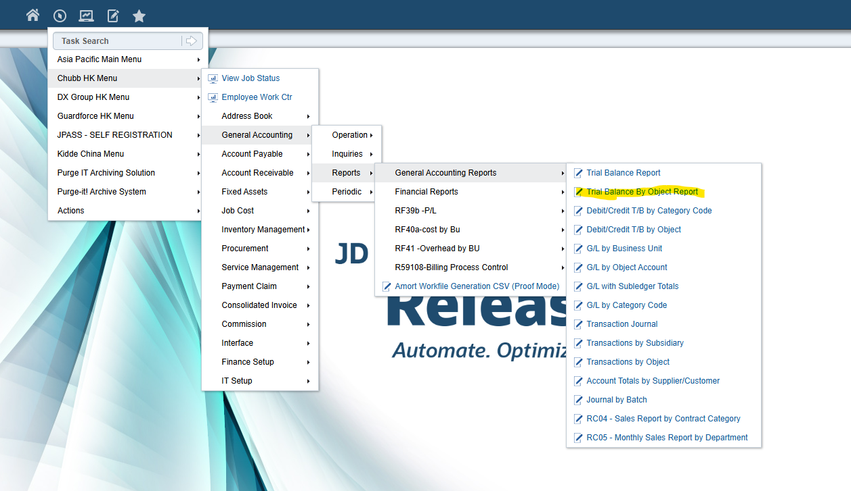
1. JDE trial balance
Step 1: Download JDE TB (use 300 Chubb Hong Kong as example)

Slide 4
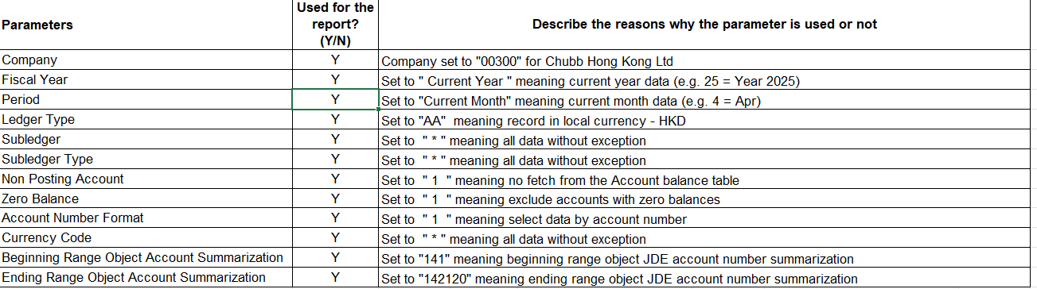
Step 2 Select in JDE Chubb HK Menu Parameter

Slide 5
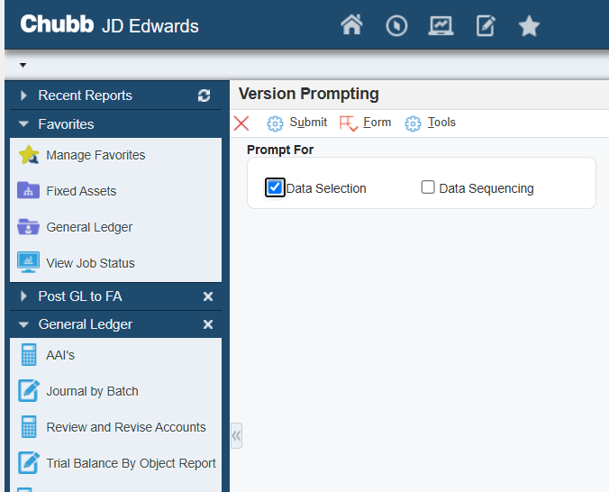
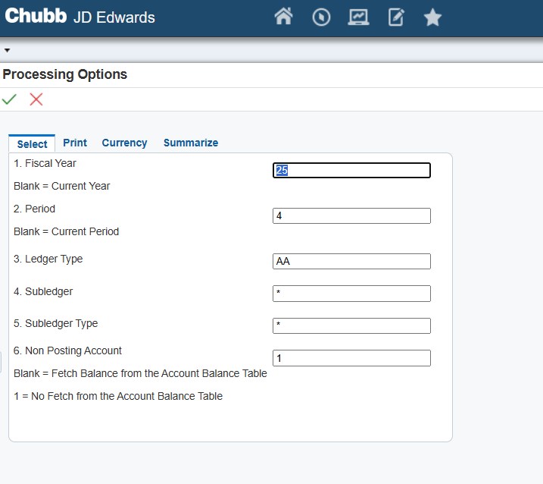
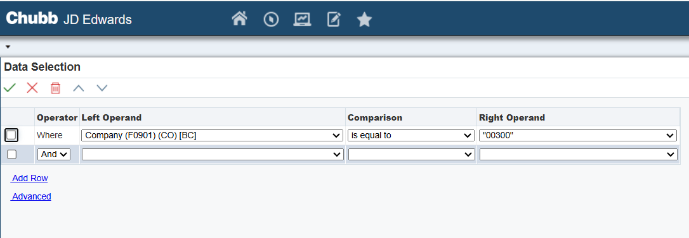

Step 3: Screenshot for download JDE TB
1
3
2

Slide 6
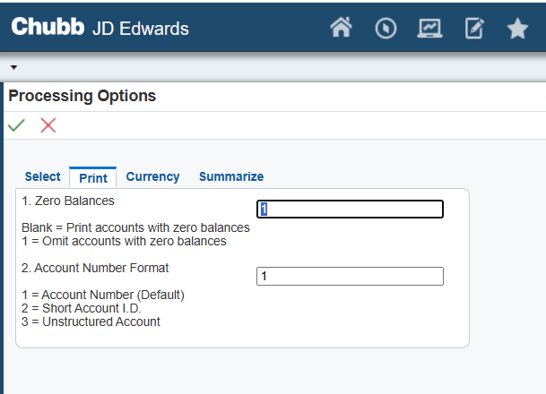
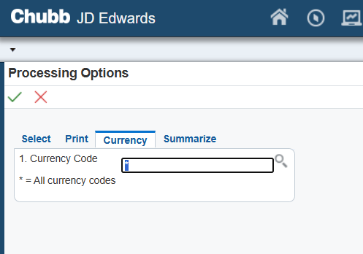
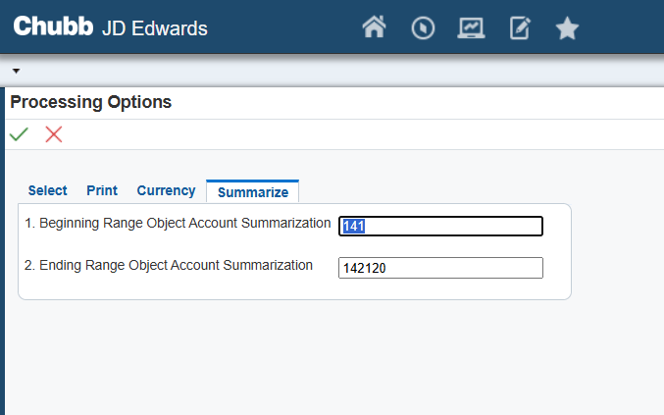
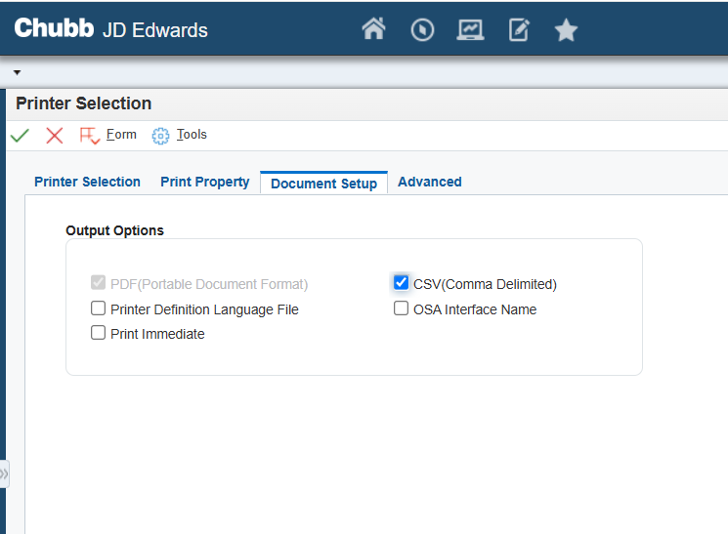
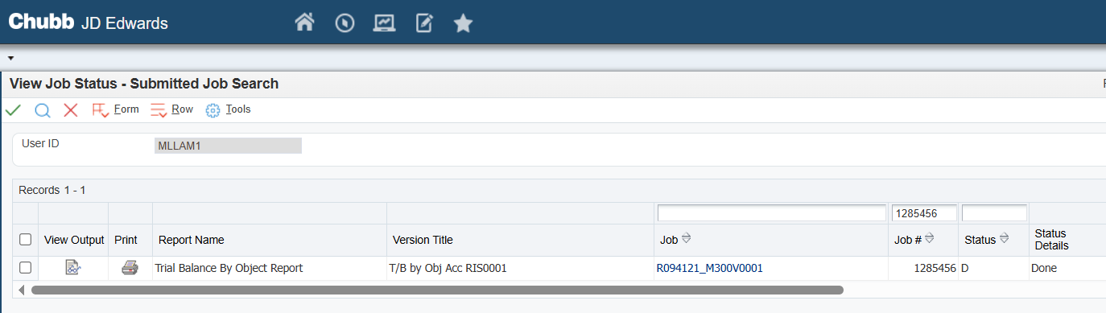
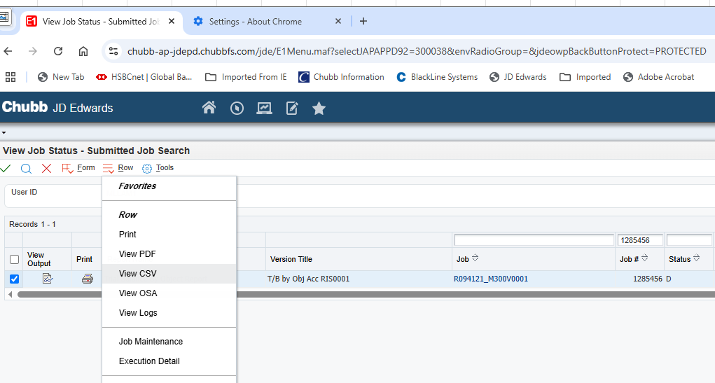
4
5
6
7
8
9

Slide 7

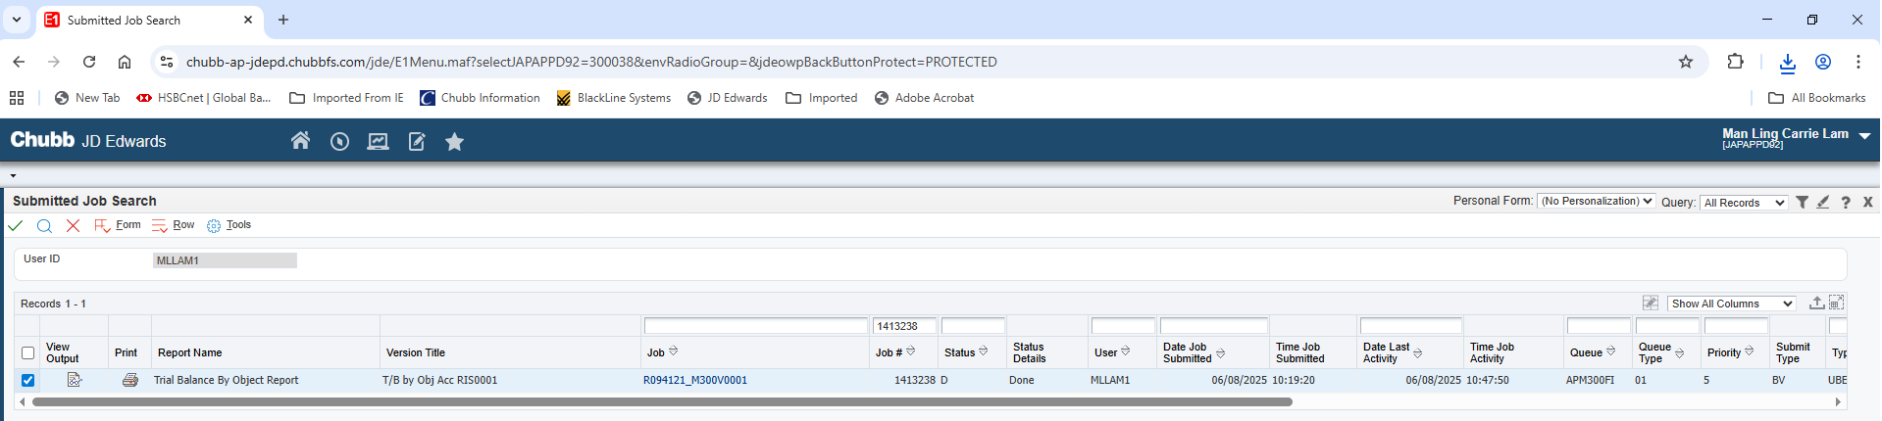
Step 4: Extract TB from JDE system

Slide 8
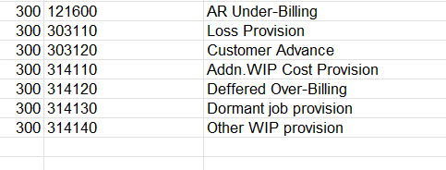
Step 5: Group the WIP account codes in your excel worksheet and summarize the Current Balance

Slide 9
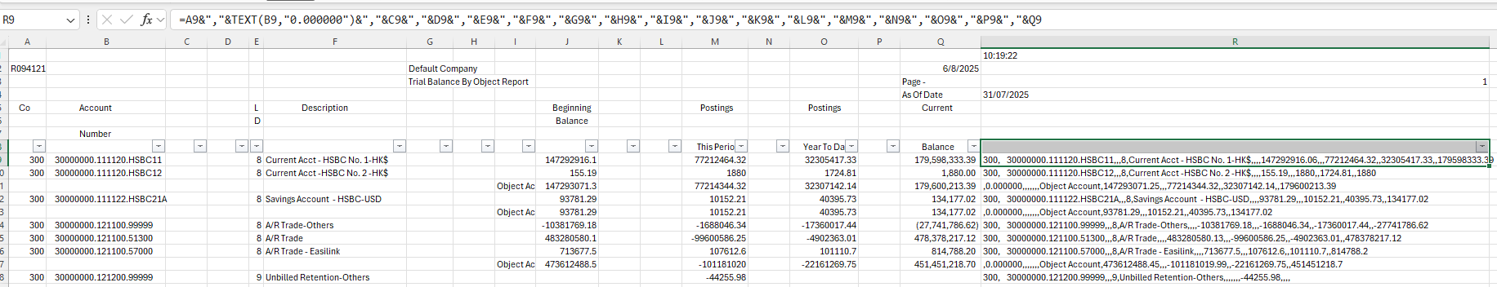
Step 6: Use excel formulas in TB download data in column “R”
=A9&","&TEXT(B9,"0.000000")&","&C9&","&D9&","&E9&","&F9&","&G9&","&H9&","&I9&","&J9&","&K9&","&L9&","&M9&","&N9&","&O9&","&P9&","&Q9

Slide 10
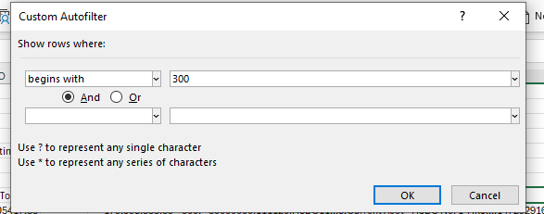
Step 7: Filter column “R” and select begins with “300”
.

Slide 11
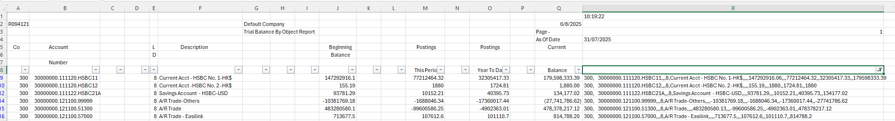
Step 8: Finally, we copy and paste the column “R“ into “Notepad” as txt file and upload it to the OneStream System.

Slide 12
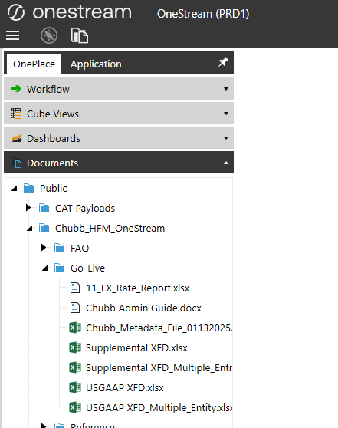
2. USGAAP XFD.xlsx
3. Supplemental XFD.xlsx
Step 1
Files are located in the onestream system – please refer to the screen for details to download

Slide 13
2. USGAAP XFD.xlsx
3. Supplemental XFD.xlsx
Step 2
The two files provide supplemental data including Fixed Assets movement , AR aging and related details.
Step 3
Populate details per the information required.

Slide 14
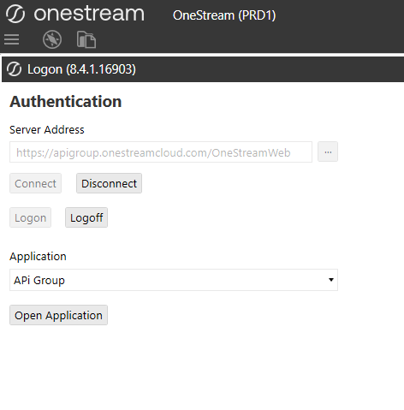
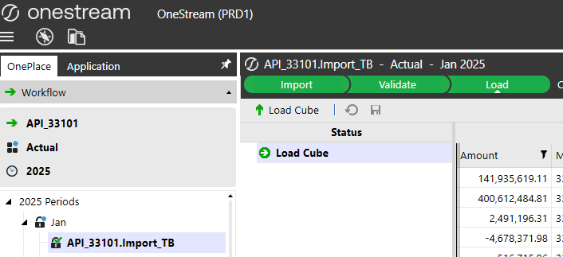
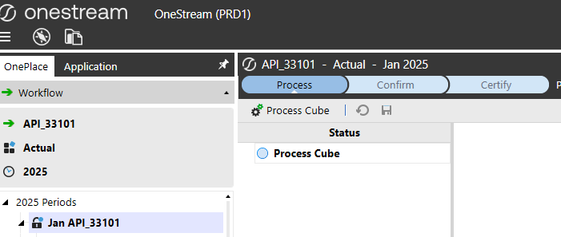
Upload Onestream System Procedures
Upload 3 text files to Onestream
1
2
3
1

