Slide 1
Create COA user guide
Prepare date: Aug 2025
Preparer: Carrie Lam

Slide 2
Introduction:
Procedures to add/ change or delete account on Charts of Accounts (COA) in JDE system and excel Onestream file

Slide 3
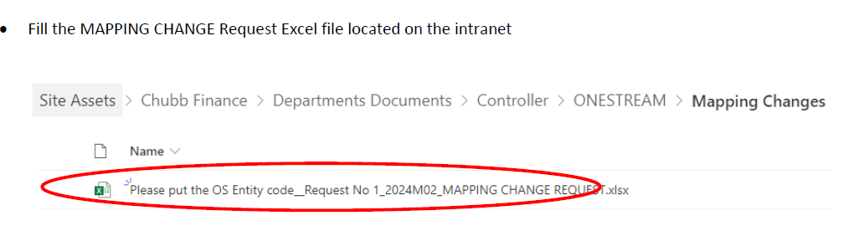
Procedures
To prepare the COA (Chart of Accounts) mapping change request form for new set up or account change in JDE and/or Onestream system. Please fill in all required fields and alignment with existing COA mapping structure. You can find the request form below in the intranet “Chubb Finance>…”

Slide 4
The preparer completes the request form and sends to approver for review.
The approver will need to review the request form to ensure accuracy and by email approval.
Once reviewed and approved by approver, the preparer updates COA in JDE system and Onestream mapping excel file.

Slide 5
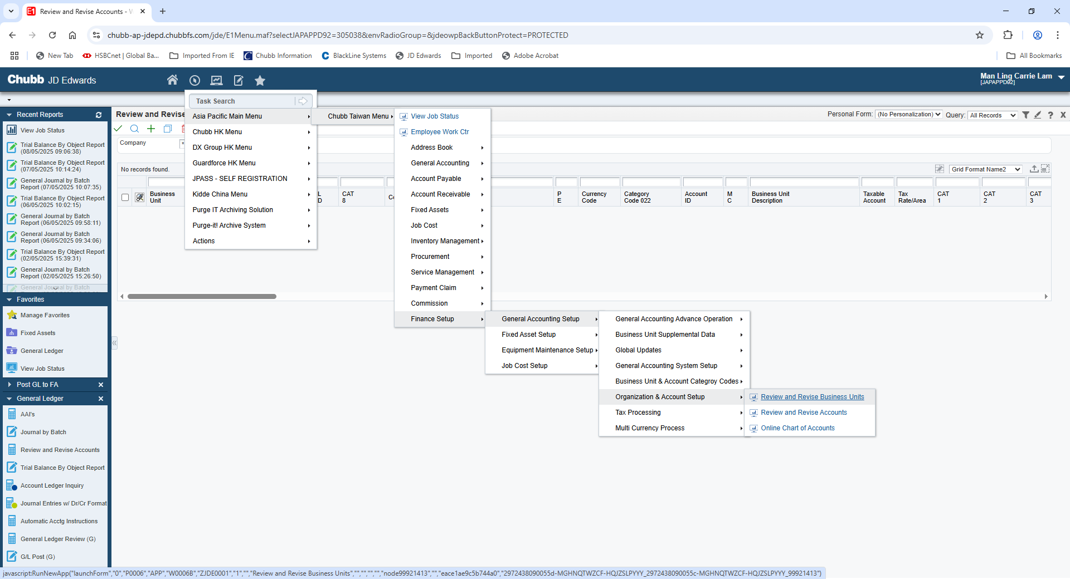
Create new COA in JDE steps
Location to add COA in JDE System

Slide 6
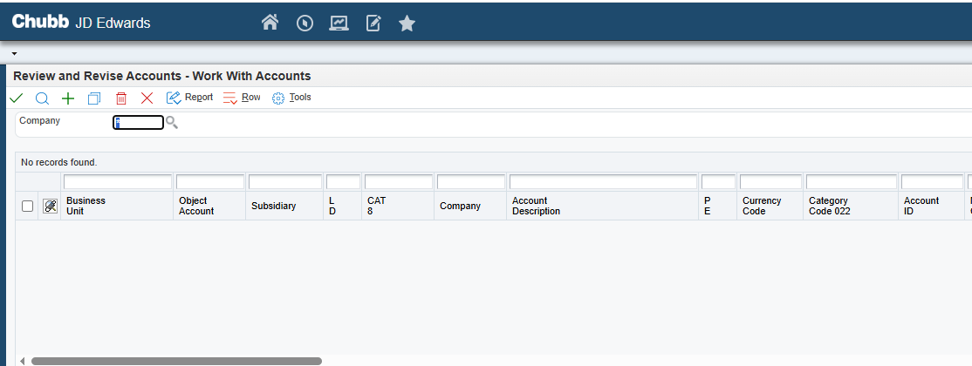
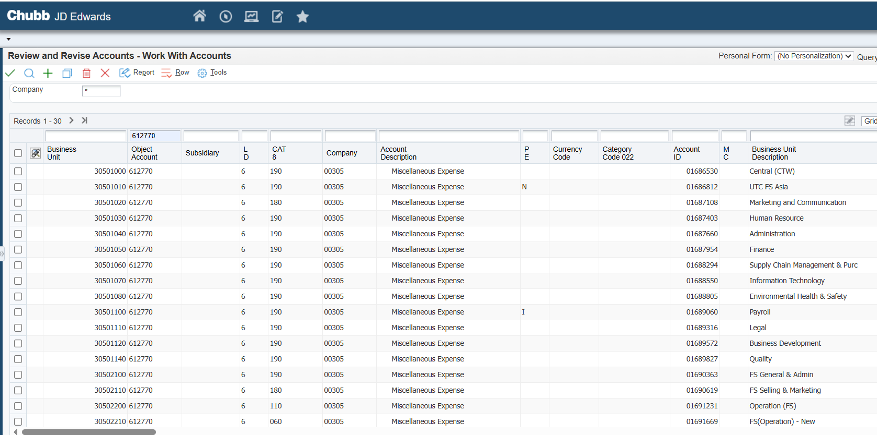

Method 1 Use “copy” function
Enter the desired account code in Object Account field and click the search icon to bring up all existing codes in JDE and display list to find the correct account code. Select the relevant code and copy it for further use.

Slide 7
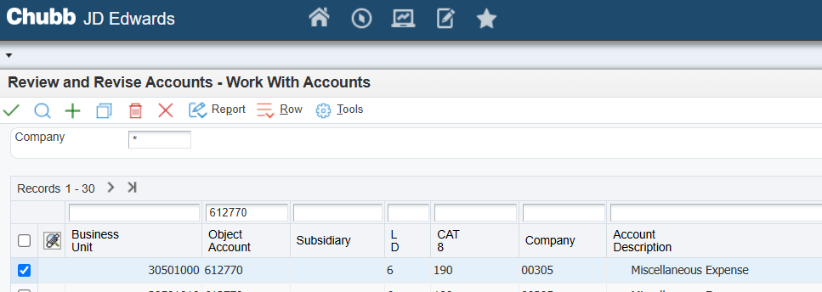

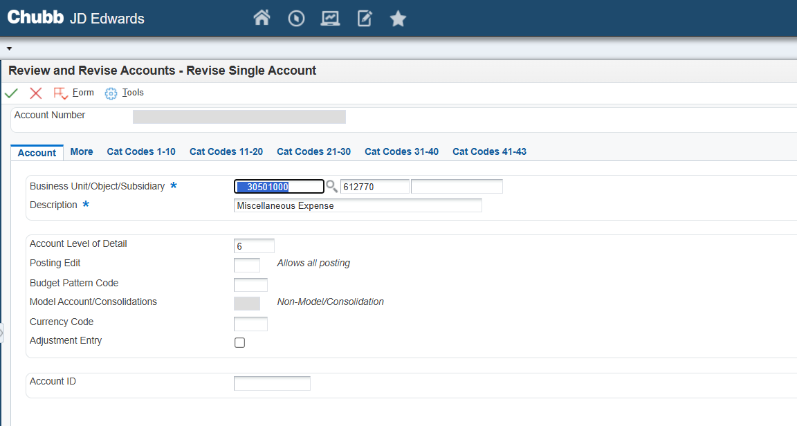
Select the account you want to use and click the copy icons
Enter the required account code and description in red field
The above steps is first method for creating a COA in JDE system.

Slide 8
Method 2 Create COA
You can manually input the required account code and description directly into each red field

Slide 9
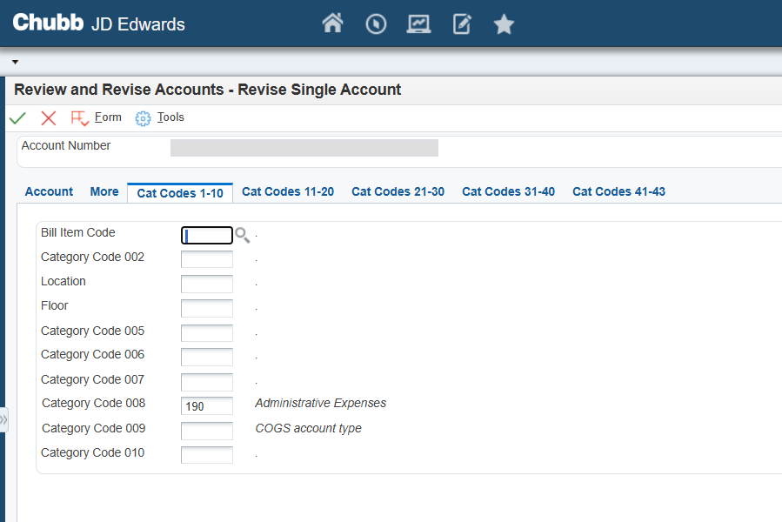
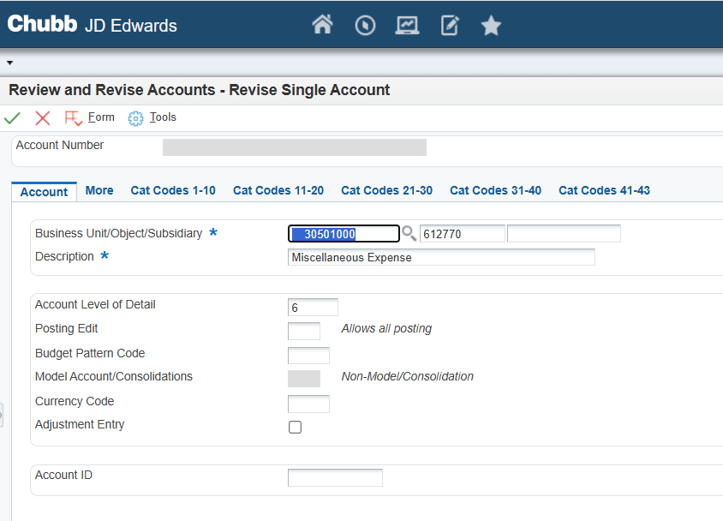

Slide 10

COA update in Onestream File
The new COA update should be reflected in the Onestream mapping excel file based on the submitted COA change form.

Slide 11
Once completed the updates in JDE, the preparer sends email to reviewer.
The reviewer validates new COA in JDE system and onestream excel mapping file for any discrepancies or errors. The reviewer sends confirmation via email once the checking process is completed.
Once reviewed, the preparer should upload the Entity code_Request No 1_Year Month_Mapping change request form in CAT system.

Slide 12
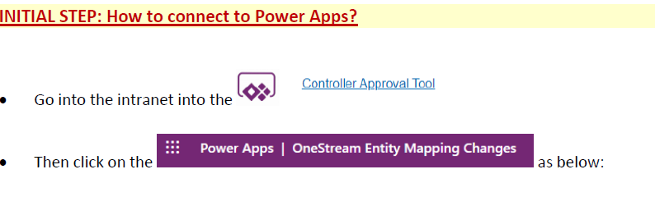

Slide 13
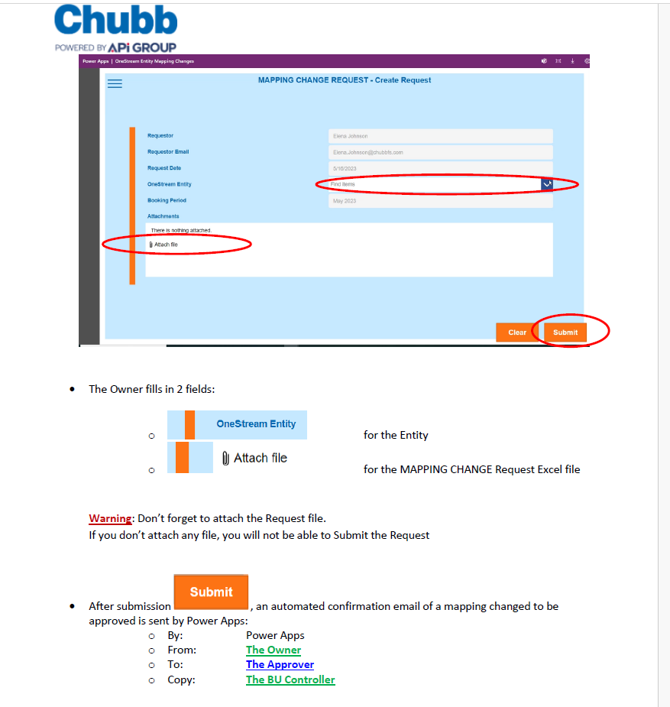
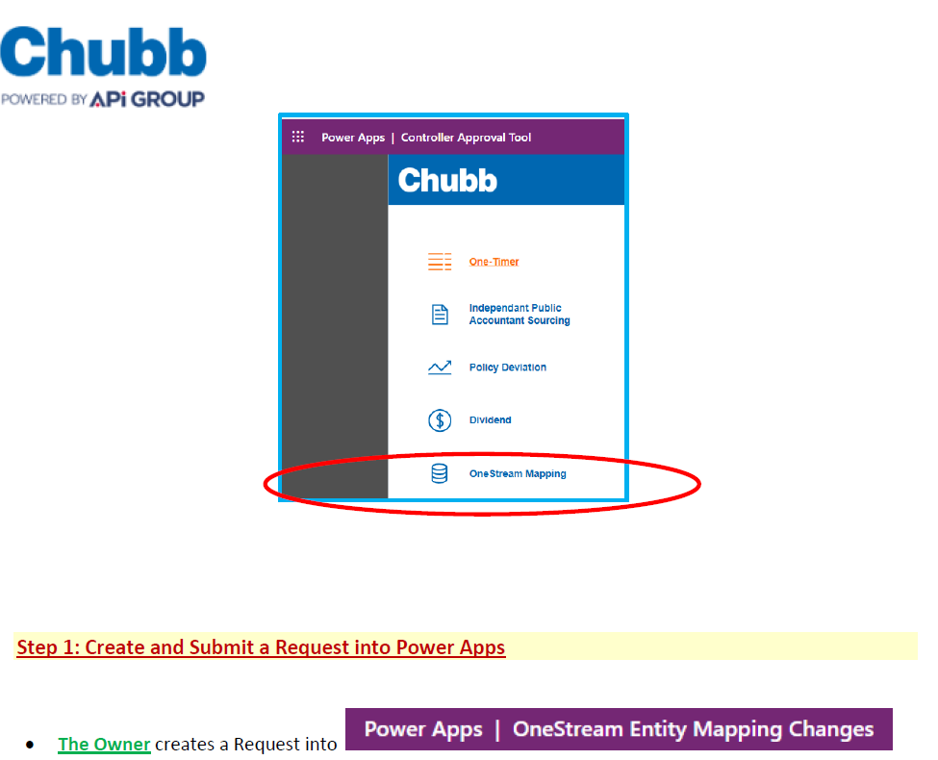

Slide 14
Final approval step is APi International reviews and approves in CAT system, they will send a notification email confirming the approval.
Once HQ staff updates the Onestream mapping table, they will send a confirmation email notifying relevant persons.

