Slide 1
AP
Account Payable
Accounts
Payable
Invoice Match Procedures
Invoice Matching · JDE Attachments · Batch Report Printing
Finance & Accounting · Invoice Match Procedures

Slide 2
Agenda
Account Payable –Invoice Processing
1.1
3-Way Matching
1.2
2-Way Matching
Voucher matched with goods receipts
Voucher without goods received
Attachment to JDE
1.3
AP Journal Voucher Printing
1.3
✦
1.4
1.4
Attach supporting documents to invoices
Print AP voucher journal by batch
1.3
Chubb – Accounts Payable | Invoice Match Procedures

Slide 3
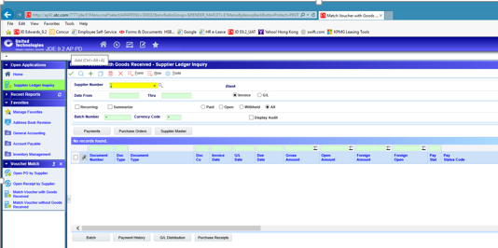
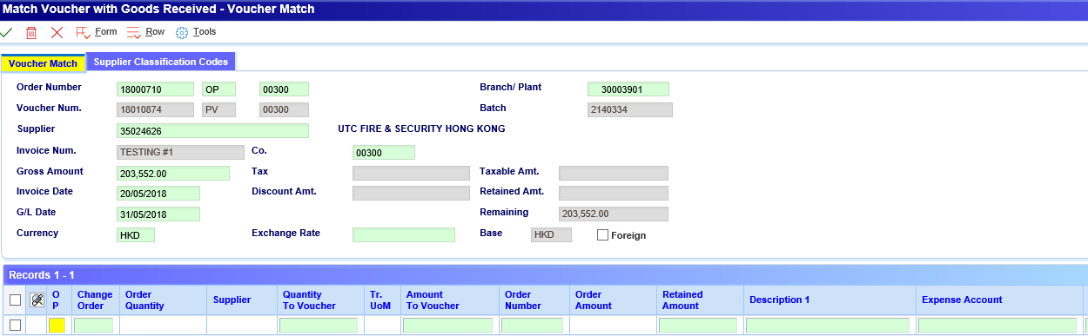
1.1 Three-Way Matching
Voucher match with goods receipts
3-Way Matching
1
Go to Operation → A/P Module → Match Voucher with Goods Received
2
Click [+] to add a new voucher
3
Complete header fields: Supplier, Invoice No., Invoice Date, G/L Date, Co., Order No. (optional)
4
Form menu → Choose Receipts to Match
5
Click [Find] to search, then select matching receipt records
6
Adjust Amount to Voucher / Quantity to Voucher as needed, then [Save]
ℹ Steps 4-6 open the Select Receipts to Match form where receipt lines are returned to the Voucher Match form.
Chubb – Accounts Payable | Invoice Match Procedures

Slide 4
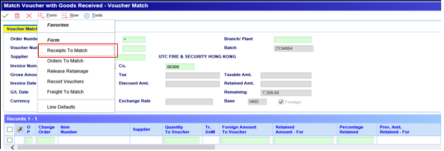
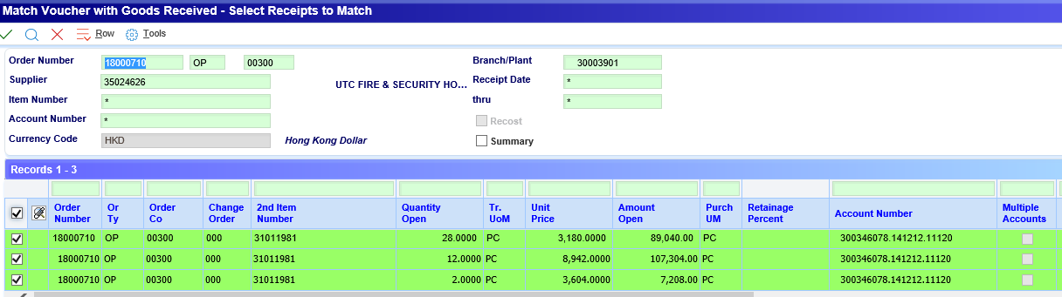
1.1 Three-Way Matching – Select Receipts
Voucher match with goods receipts
3-Way Matching
Choose Receipts To Match from the Form menu
Selected receipt lines returned to Voucher Match form
Optional fields in receipt records: Amount to Voucher | Quantity to Voucher Click [Save] to complete the voucher.
Chubb – Accounts Payable | Invoice Match Procedures

Slide 5
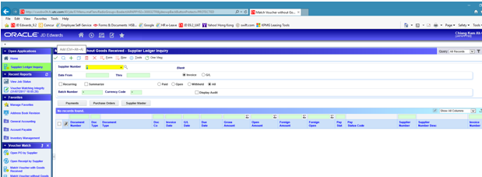
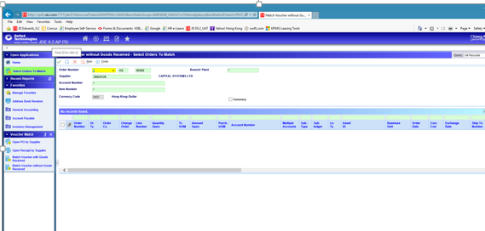
1.2 Two-Way Matching
Voucher Match without goods received
2-Way Matching
1
Go to Operation → A/P Module → Match Voucher without Goods Received
2
Click [+] to add a new voucher
3
Complete fields: Supplier, Invoice No., Gross Amount, Invoice Date, G/L Date, Order No. (optional)
4
Form menu → Choose Orders to Match
5
Click [Find], then select the order detail lines and click [OK]
6
On Voucher Match, adjust Retained Amount if required, then [Save]
ℹ Order lines selected from 'Select Orders to Match' are returned to the Voucher Match form.
Chubb – Accounts Payable | Invoice Match Procedures

Slide 6
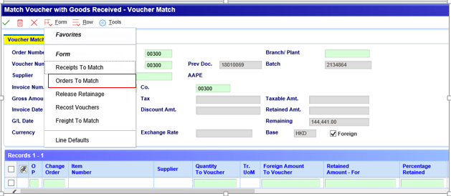
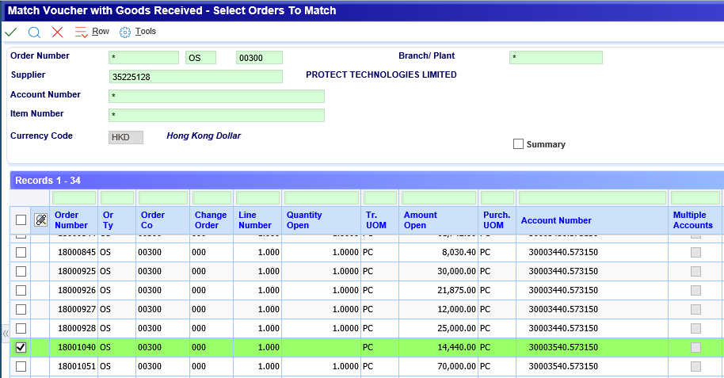
Voucher match with goods receipts
1.2 Two-Way Matching – PO Lines
2-Way Matching
Choose Order To Match from the Form menu
Selected PO lines returned to Voucher Match form
Optional fields in records: Amount to Voucher | Click [Save] to complete the voucher.
Chubb – Accounts Payable | Invoice Match Procedures

Slide 7
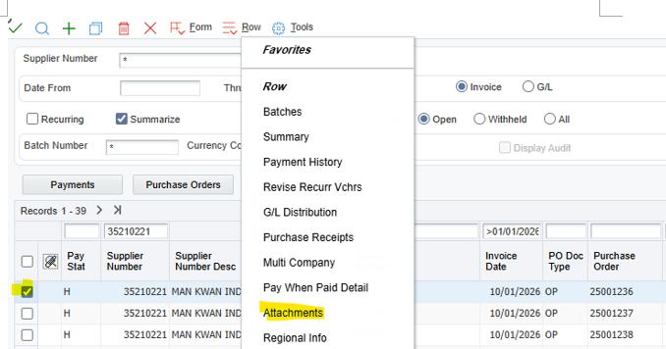
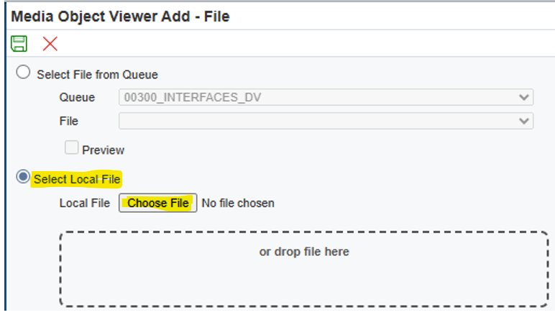
1.3 Attach Invoice and Supporting to JDE
Attach supporting documents to invoice records
JDE Attachment
1
Open the invoice record and select 'Attachments'
2
Click 'File' in the attachments panel
3
Click 'Select Local File' and choose the file from your computer
4
Click [Upload / Save] to upload the selected file
5
Click [Save] again to confirm and finish attaching the document
ℹ Supported file types include PDF, Excel, Word, and image files. Files are linked directly to the JDE record.
Chubb – Accounts Payable | Invoice Match Procedures

Slide 8
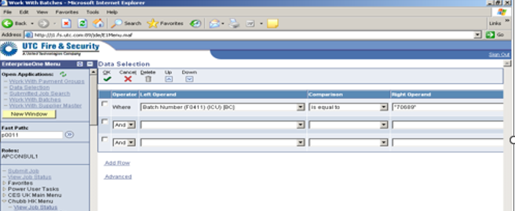
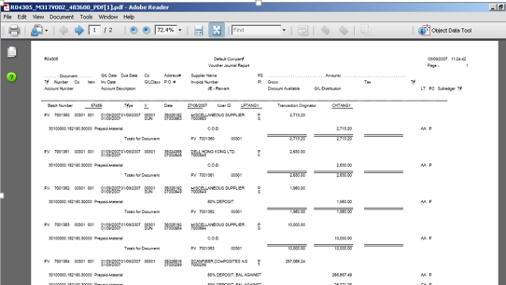
1.4 AP Journal Voucher Printing
Print AP Voucher Journal by Batch
Voucher Journal Printing
1
Go to AP Report → AP Detail Reports → AP Voucher Journal by Batch
2
In Data Selection, enter the batch number and click [OK] to proceed
3
In Processing Option, enter 1 to print account numbers in format BU.Object.Subsidiary
4
In Printer Selection, click [OK] to submit the final job
5
The PDF output file is generated and available for review
6
Send the batch report to manager for review and approval
ℹ Processing option '1' formats account numbers as Business Unit.Object.Subsidiary in the printed report.
Chubb – Accounts Payable | Invoice Match Procedures

Slide 9
Order Type Reference
Voucher Matching Eligibility by Order Status
Reference Table
Order Type | Last Status | Next Status | Can Be Voucher Matched?
OK, ON, OP | 290 | 400 | No — waiting for goods receipt.
OK, ON, OP | 400 | 400 | Yes — via [Form → Receipts to Match]. Partial receipts for OK/ON, or partial receipts or issues for OP.
OK, ON, OP | 400 | 999 | Yes — via [Form → Receipts to Match] for full receipts (OK/ON) or full receipts & issues (OP). No – full voucher match is already done.
OS, OT | 290 | 400 | Yes.
OS | 400 | 400 | Yes — via [Form → Order to Match]. This is a partial voucher match.
OS | 400 | 999 | No — full voucher match has already been completed.
Voucher match allowed
Voucher match not allowed
Chubb – Accounts Payable | Invoice Match Procedures

Slide 10
Key Takeaways
1
3-Way Matching links invoices to goods receipts for full PO control
2
2-Way Matching is used for service/non-receipt POs via order lines
Finance & Accounting
Accounts Payable Team
3
Supporting documents should be attached to each JDE invoice record
4
Print Voucher Journal Batch and Send to Manager for Review and Approval
5
Chubb – Accounts Payable | Invoice Match Procedures

