Slide 1



CHINA CAPABILITY CENTER - Finance
APRIL 2026

Slide 2

End to End Finance Process (2026-27)
Segregation of responsibilities between Local Finance and CCC ensures control and scalability
Hong Kong | Macau | Mainland China > China Capability Center (CCC)
HK-Business partnering HKMC-FP&A & performance management HK-Statutory accounts and tax¹ HKMC-Cash management and credit control (SideTrade) HKMC-Exception handling and issue resolution | Macau-Business partnering Macau-Statutory accounts and tax¹ HKMC-Month‑end review and sign‑off HKMC-Non‑standard journal entries HKMC-Master data governance² | CN-Business partnering Strategic sourcing (1HC) CN-Statutory accounts¹ and Local tax compliance (1HC) | 3. General Ledger (3HC) Account reconciliations Standard journals Depreciation Intercompany accounting 4. Accounts Payable (3HC) Staff Reimbursements Invoice processing and validation Payments 5. Cash Application (1HC) 6. Standard Reporting (1HC) Routine financial reporting preparation 7. Projects Accounting Project billing and settlements
Control & Transformation Outcomes
Clear segregation of responsibilities improves internal control
Standardized execution enables consistency and audit readiness
CCC supports regional scale without proportional headcount growth
Local finance remains focused on value‑added activities and business support
Note: 1. Potential to consolidate into a single local region.
2. Potential migration to the CCC, subject to the suitability of the business activities.

Slide 3
Finance Process Schedule
Process | Jan | Feb | Mar | Apr | May | Jun | Jul | Aug | Sep | Oct | Nov | Dec | Owner
Journal Entries (Recurring) |  |  |  |  |  |  |  |  |  |  |  |  | CCC Fin
Accounts Reconciliation |  |  |  |  |  |  |  |  |  |  |  |  | CCC Fin
Concur |  |  |  |  |  |  |  |  |  |  |  |  | CCC Fin
AP Input invoices – 3 ways match |  |  |  |  |  |  |  |  |  |  |  |  | CCC Fin
Fixed Asset Management |  |  |  |  |  |  |  |  |  |  |  |  | CCC Fin
Master Data Governance -Vendor -Fixed Assets -Customer -COA -TB/OS mapping |  |  |  |  |  |  |  |  |  |  |  |  | Macau
Dispute Management – SideTrade |  |  |  |  |  |  |  |  |  |  |  |  | HK
AR Settlement System – BlackLine |  |  |  |  |  |  |  |  |  |  |  |  | CCC Fin
CCHL, Taiwan, China x5
2026 Jun
Macau/ACSL CHK
All
2026 Jan
All
2026 Feb
Macau, China
2026 Jun
ACSL, CHK - TBC
All
2026 Jan
Vendor: Macau, China x5
Fix Assets: Macau, China x5
Vendor: CHK x4 S
Fix Assets: CHK x3 Customer: All
COA and others: TBC
2026 Aug
2026 Jun
2026 Q4
Now

Slide 4
Q1 Performance Metrics & Key Challenges
Total Recon
579
Total Concur
370
Total 3-way Match
586
Total Journal Entries
87
Recon Accuracy
89.5%
Recon SLA %
97%
Reconciliation by region
Concur by region
Timely Completion for Recon
Key KPI Target
Average manpower: 3.3 HCs (Q1)
Recon: 100% before the 20th monthly
Concur review: ≤ 5 working days
3‑way match: ≤ 7 working days / invoice
JE: 100% timeliness & accuracy
Cross‑role backup established
Challenge
One CCC team supporting 11 legal entities across three regions
Manual documentation and paper‑based processes in certain workflows
Systems access and cross‑entity alignment during close cycles
Risk
Recruitment timing may affect resource onboarding and the overall transition timeline. (FP&A +1 from Q4 2025)
Vender communication: The transition to electronic invoice submission needs further supplier communication and stabilization time.

Slide 5
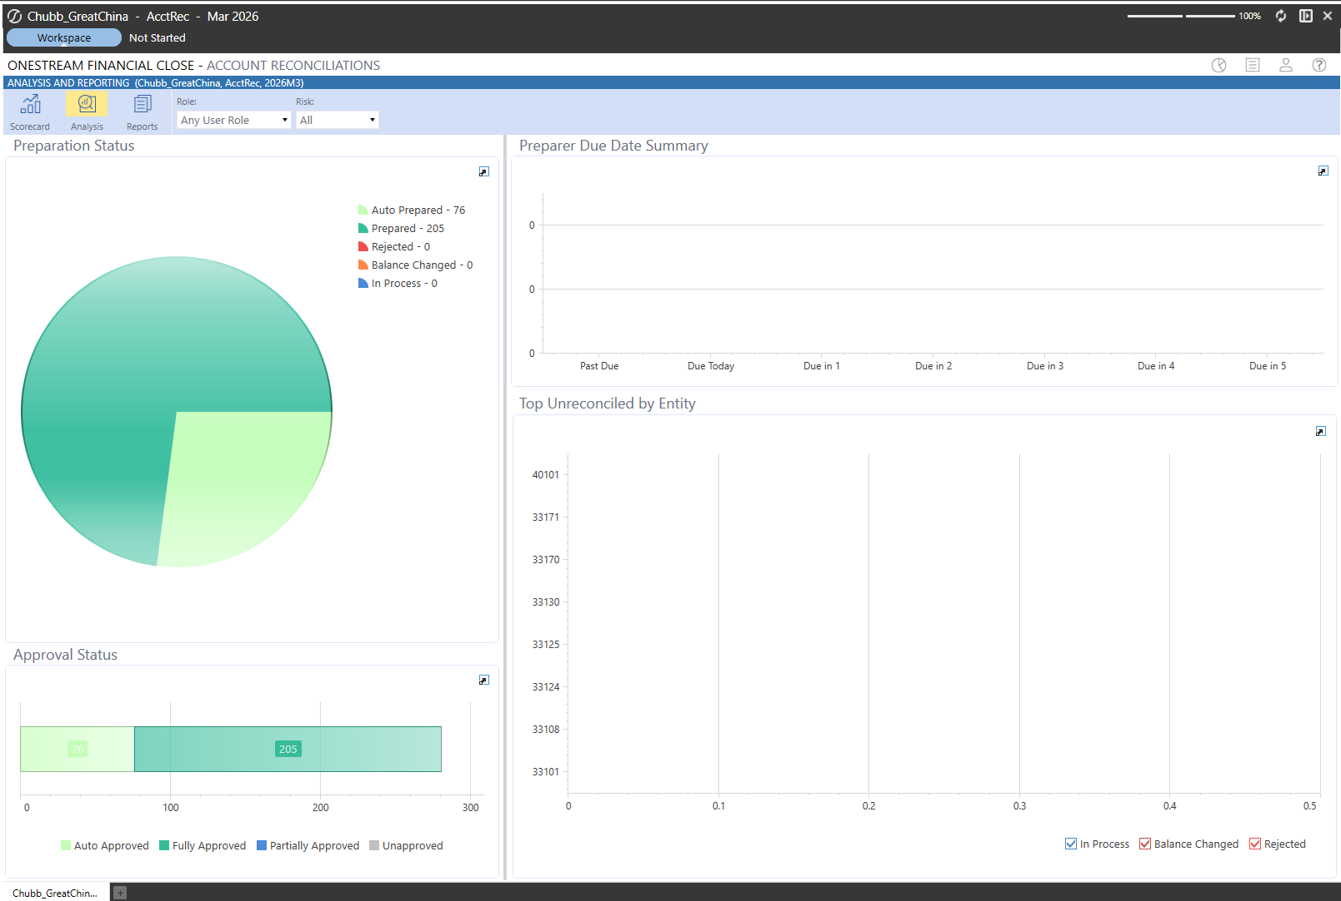
KPI - Q1 Accounts Reconciliations [Agreed]

Slide 6
Questions

