Slide 1
MSR: China
FCST 7 + 5

Slide 2
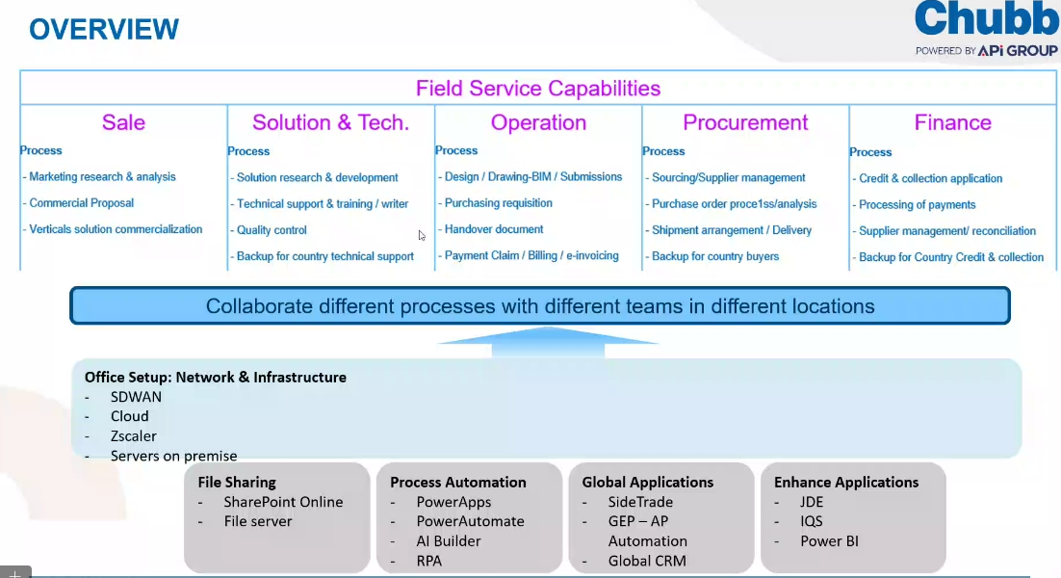

Slide 3
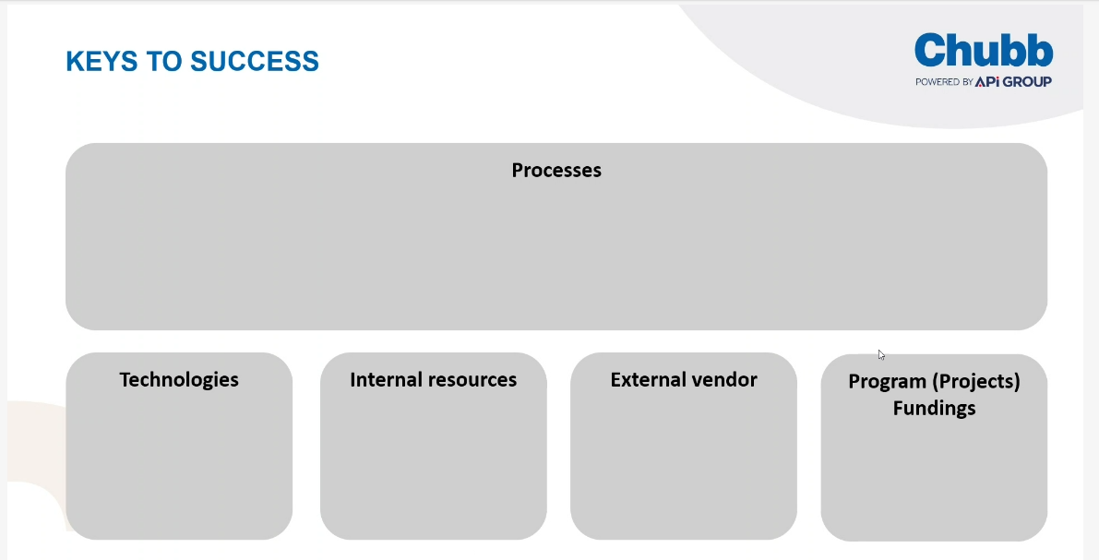

Slide 4
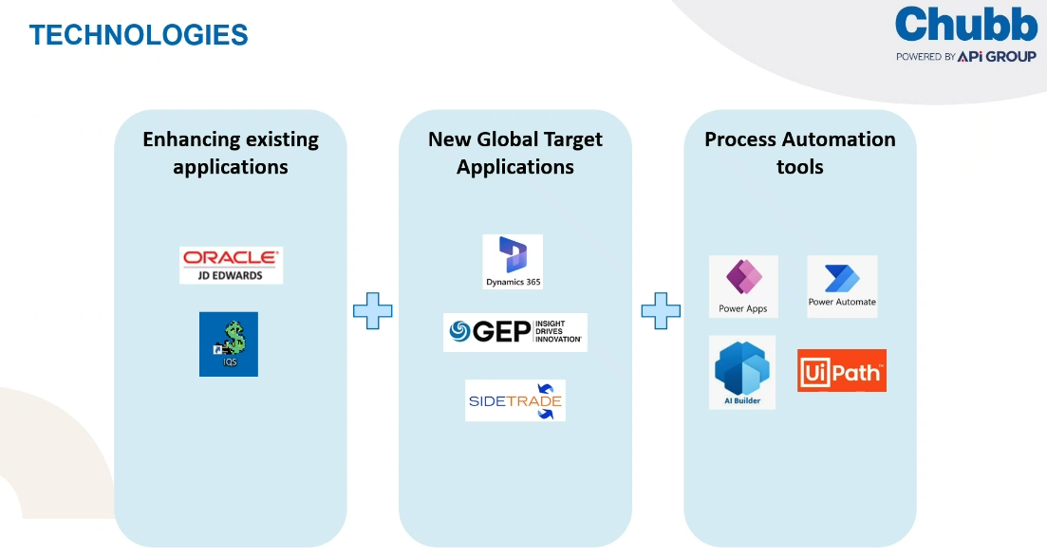

Slide 5
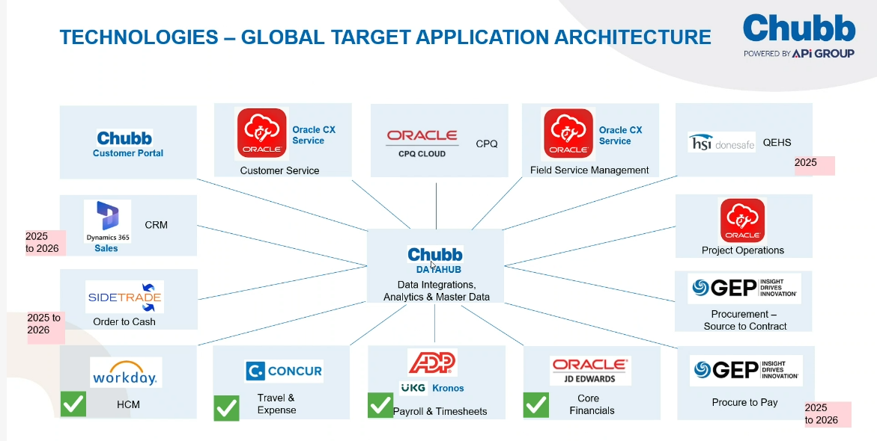

Slide 6
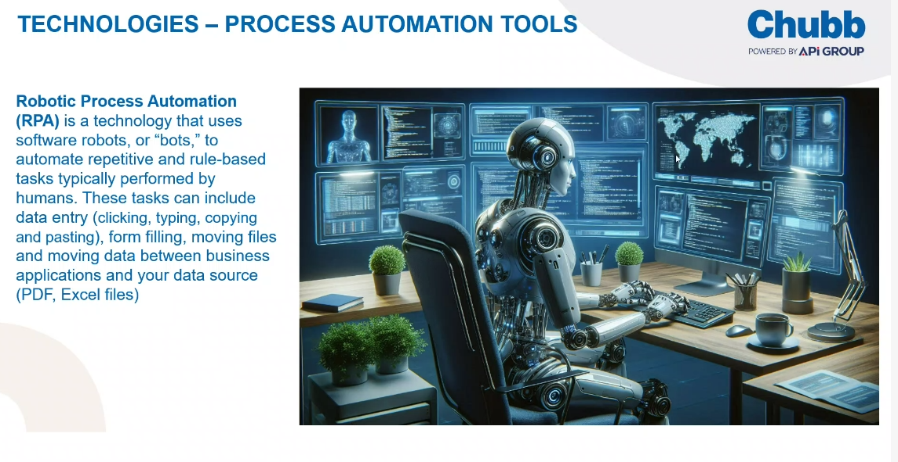

Slide 7
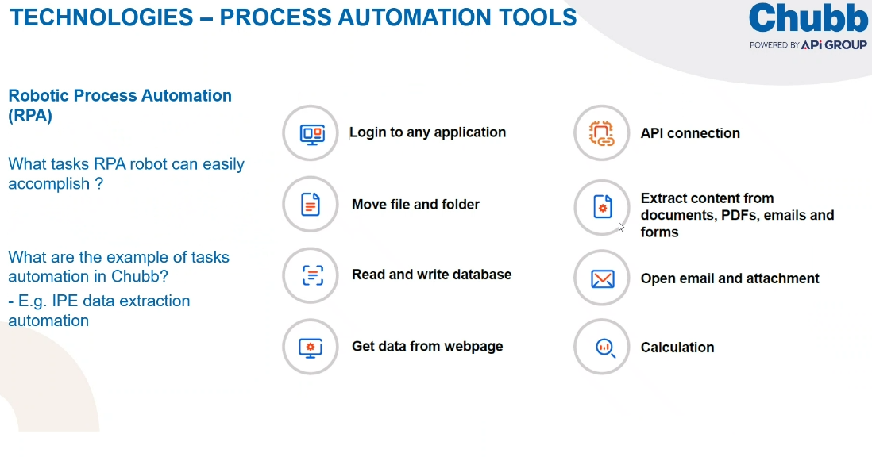

Slide 8
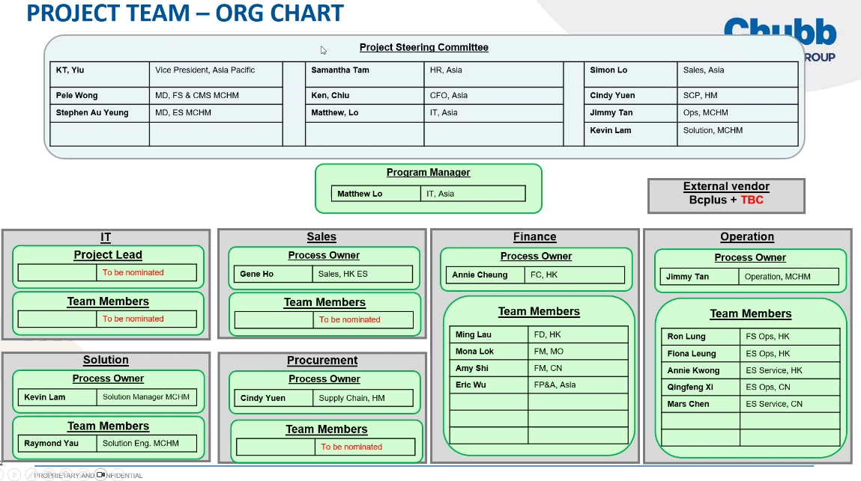

Slide 9
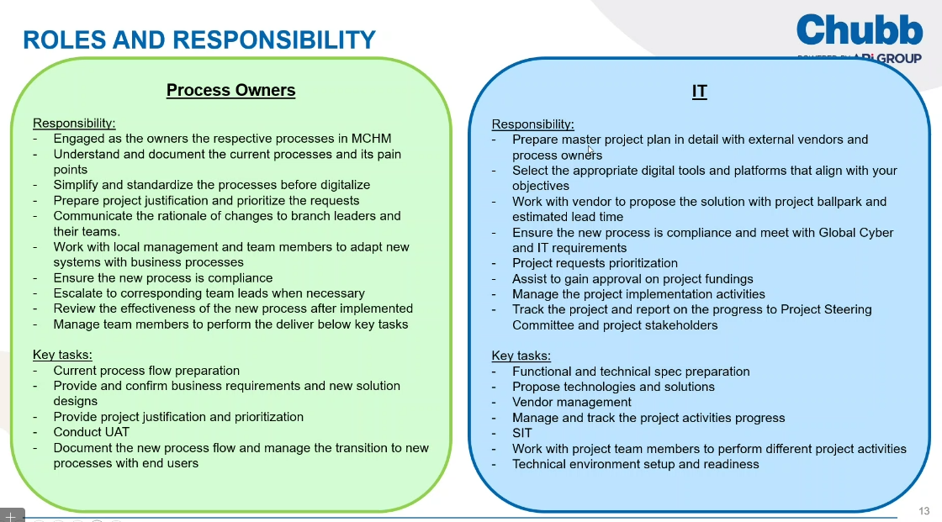

Slide 10
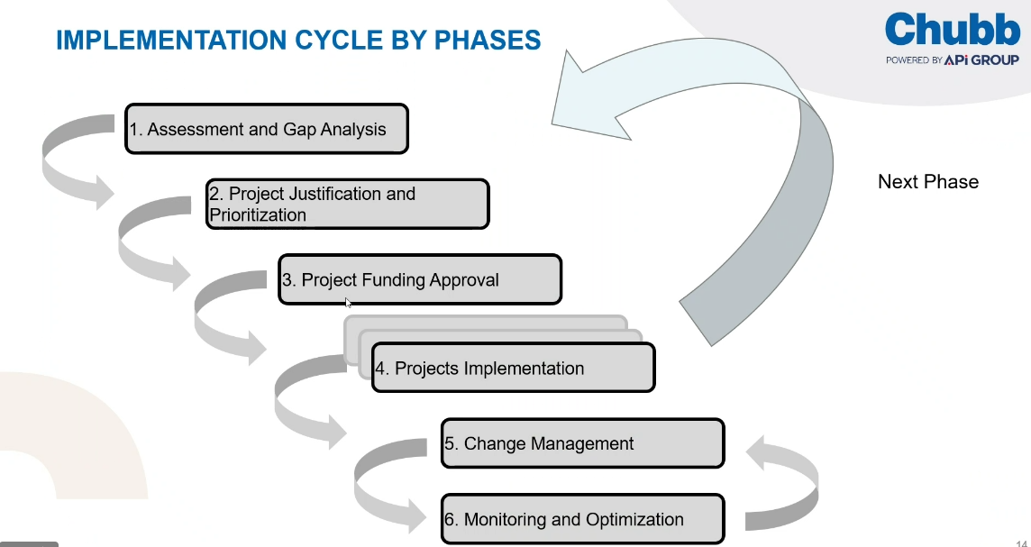

Slide 11
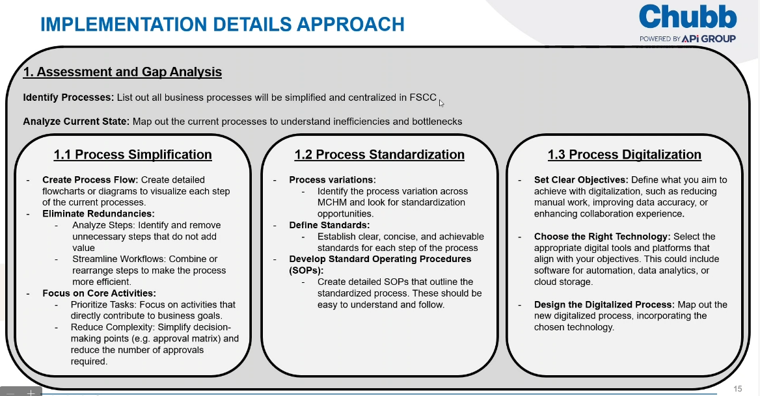

Slide 12
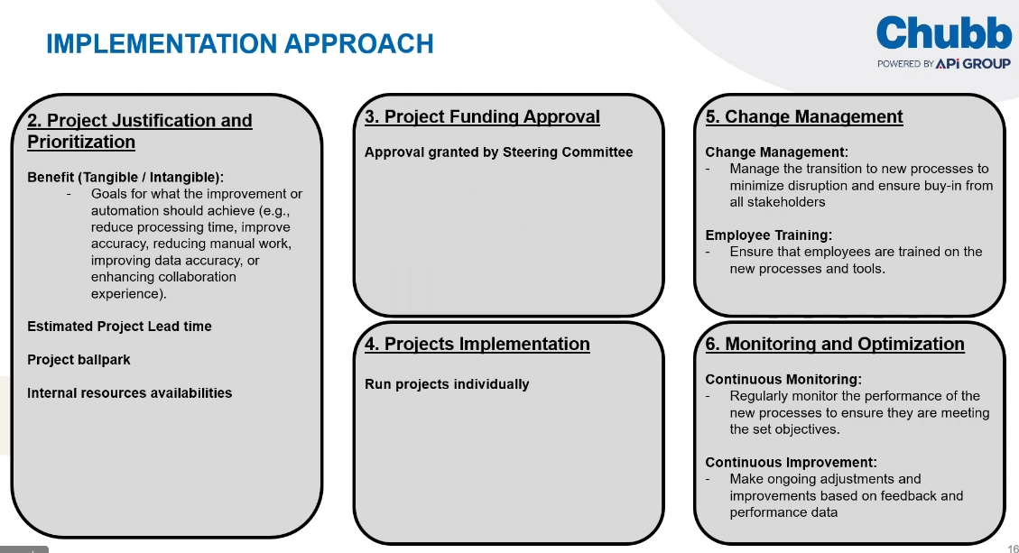

Slide 13
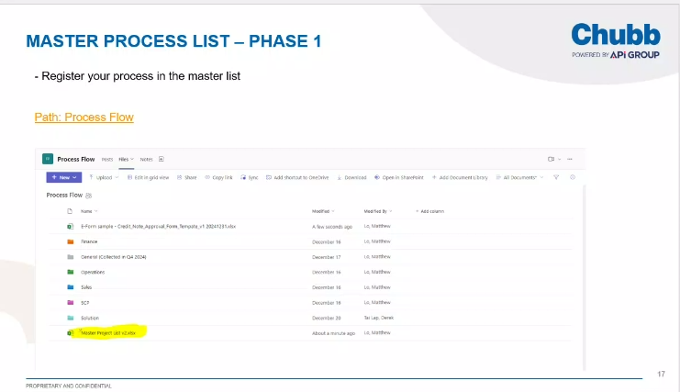

Slide 14
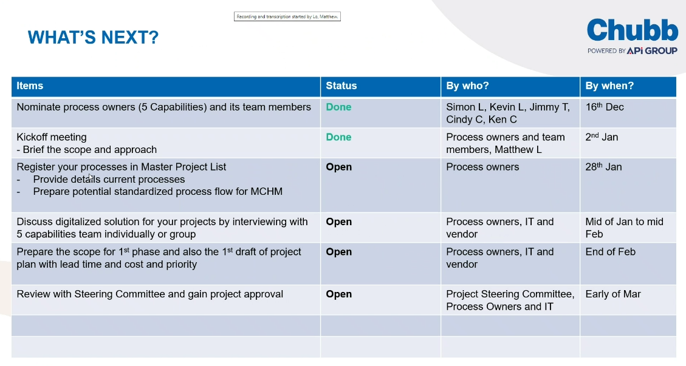

Slide 20
Performance
Jul
YTD
Full year

Slide 21
Regional bridge for Jul
Performance Vs. FCST for Jul by LOB
Entity | LOB | Year | Period | Scenario | Performance (K) | Budget (K) | Differnce | Risk assessment | Bridge
China | Install | 2023 | YTD | 7 + 5 Forecast | 5,110 | 12,888 | - 7,778 |  | 6.8m Jockey club bidding loss, 1.5m Key projects delay to H2: (0.4 Hang Lung, 0.2m Rolex ups, 0.2m Aptiv, 0.1m Cognizant, 0.1m STELLANTIS, 0.1m Xiangya Hospital, 0.3m GMC project).
China | Install | 2023 | Full year | 7 + 5 Forecast | 12,254 | 22,094 | - 9,840 | Three region roll up P8 LE: 9,079, gap 3,175 have potential pipeline opportunity. | 12,254 should be P1-P7 actual plus P8-P12 66FCST. Weak pipeline due to economic recovery slower than expectation.
Entity | LOB | Year | Period | Scenario | Performance (K) | Budget (K) | Differnce | Risk assessment | Bridge
China | Do and Charge | 2023 | YTD | 7 + 5 Forecast | 444 | 463 | - 19 |  | VP almost flat. VPY has 137% YOY increase.
China | Do and Charge | 2023 | Full year | 7 + 5 Forecast | 891 | 794 | 97 | VP 97K opportunity. | VPY increase 232%. Strong push forward on D&C in 2023 (e.g. commission inspiration).
Entity | LOB | Year | Period | Scenario | Performance (K) | Budget (K) | Differnce | Risk assessment | Bridge
China | PF Additions | 2023 | YTD | 7 + 5 Forecast | 220 | 489 | - 269 |  | Due to weak pipeline.
China | PF Additions | 2023 | Full year | 7 + 5 Forecast | 386 | 838 | - 452 | Have on-hand 0.7m new additional pipeline opportunity.(0.3m bytedance, 0.2m sephora, 0.1m Herbalife, others 0.1m)
Entity | LOB | Year | Period | Scenario | Performance (K) | Budget (K) | Differnce | Risk assessment | Bridge
China | Cancellation | 2023 | YTD | 7 + 5 Forecast | - 97 | - 88 | - 10 |  | Customer retrofit. Site move, change maintenance contract model for cost saving.
China | Cancellation | 2023 | Full year | 7 + 5 Forecast | - 160 | - 150 | - 10 |  | Will try to mitigate the YTD GAP of 10K in H2 to keep full year flat.

Slide 22
pipeline
Installation
- Fire Safety
- PFX
- Electronic Security

Slide 23
Top expected opportunities for current and next month
Installation in Electronic Security
请销售经理补充sales stage和created date.
其他信息请review如有更新请更改
Opportunity Name | Sales rep | Vertical | Sales stage | Confidence | Created date | Expected date | Value(K)
Renaissance Pharmaceuticals(复兴) HQ Security | Karl Kong | Commercial | Proposal | 50% |  | Sep | 732
Cognizant Security transformation | Karl Kong | Commercial | Bidding | 50% |  | Aug | 104
Duo Yun Xuan ELV renovation | Karl Kong | Commercial | Win | 50% |  | Aug | 131
GMC General Motors Park Renovation | Mike Zhong | Industry | Quotation | 50% |  | Aug | 261
Rolex UPS | East | Retail |  | 90% |  | Aug | 185
Rolex Switch | East | Retail |  | 70% |  | Sep | 131
HSBC Shanghai ITC Branch | Song Min | Financial |  | 30% |  | Aug | 131
Bvlgari Wuhan | Sophie Xue | Retail |  | 50% |  | Aug | 91
Bvlgari Nanchang | Sophie Xue | Retail |  | 50% |  | Sep | 91
Hanglung General Access Control Renovation | Mike Zhong | Commercial |  | 70% |  | Aug | 78
Ralph Lauren Shanghai Flagship Store | Ada Li | Retail |  | 50% |  | Sep | 78
APTIV Chongqing Factory Renovation | Mike Zhong | Industry |  | 50% |  | Sep | 65
APTIV Jiading Factory Access Control Renovation | Mike Zhong | Industry |  | 70% |  | Aug | 131
LVMH Cloud Eye Science | Ada Li | Retail |  | 90% |  | Aug | 51
Mondelez Beijing Factory Access Control Renovation | Mike Zhong | Retail |  | 50% |  | Aug | 65
Mondelez Suzhou Monitoring and Transformation | Mike Zhong | Retail |  | 50% |  | Aug | 44
BeiGene(百济神州)Security Project | Sunny Song | Commercial |  | 50% |  | Aug | 451
Hanglung anti-terrorism transformation | Luca Chen | Industry |  | 50% |  | Aug | 65
Hermès Shenzhen MIXC New Store | Natasha Chen | Retail |  | 50% |  | Sep | 131
Hermès Beijing Sanlitun peripheral monitoring | Natasha Chen | Retail |  | 70% |  | Sep | 60
alarm to the perimeter of the Italian Embassy | North | Commercial |  | 70% |  | Sep | 52
Tetra Pak(利乐) Kunshan Factory Security Upgrade | Luca Chen | Commercial |  | 50% |  | Aug | 273
Total |  |  |  |  |  |  | 3,403

Slide 24
Major cancelled/lost installations in Jul
Installation in fire safety
请销售经理补充7月丢失的installation项目
Opportunity Name | Sales rep | Vertical | Value ($K) | Reason | Learnings
Guangzhou Jockey Club project | Karl Kong | CNI | 6800 | GC lost their tender | Need more evaluation the GC’s advantage /risk

Slide 25
Portfolio
Additions
- Electronic Security
Renewals
- Electronic Security

Slide 26
Key New Contract Opportunities for current + 2 months for ES
请销售经理补充sales stage和created date.
其他信息请review如有更新请更改
Opportunity Name | Sales rep | Vertical | Sales stage | Confidence | Created date | Expected date | Value ($K)
Ralph Lauren | Ada Li | Retail | Bidding | 70% |  | Aug | 14
WPP(群邑) | Luca Chen | Commercial | Bidding | 70% |  | Aug | 8
PUBLICIS GROUPE | Yang Ming | Commercial | Quotation | 90% |  | Aug | 7
Metro | Mike Zhong | Retail | Bidding | 30% |  | Q4 | 27
Herbalife | Mike Zhong | Commercial | Bidding | 30% |  | Q4 | 70
Sephora | Ada Li | Retail | Bidding | 50% |  | Q4 | 74
Bytedance | Karl Kong | IT/DC | Bidding | 50% |  | Q4 | 295
Total |  |  |  |  |  |  | 494

Slide 27
Key contract renewals for current + 2 months for electronic security
请销售经理补充sales stage和created date.
其他信息请review如有更新请更改
Opportunity Name | Sales rep | Vertical | Sales stage | Confidence | Created date | Expected date | Value ($K)
LVMH Shops Nationwide (3 three years frame contract win in Aug) | Ada Li | Retail | Win | 100% | Jan | Aug | 137
CICC | Natasha Chen | Financing |  | 70% | Jan | Aug | 13
Forever mark | Karl Kong | Retail |  |  | Jan | Aug | 15
Others (expired before Oct) |  |  |  |  | Jan | Aug to Oct | 169
Total |  |  |  |  |  |  | 334

Slide 28
Major cancellations/lost contracts for May in electronic security
请销售经理补充Learning
Opportunity Name | Sales rep | Vertical | Value ($K) | Reason | Learning
Spanish Santander Bank SH Branch 西班牙桑坦德银行上海分行 | 薛, 素慧 | Banking | 3 | customer make renovation
Public parking lot 2022maintenance 大众停车场2022年维护 | Natasha Chen | Industry | 9 | customer budget canceled, non-renewal
Taiwan SME Bank Wuhan Branch 台湾中小企业银行武汉分行 | 宋, 敏 | Banking | 2 | price
Shanghai Nap-Macquarie Shanghai Beijing Office Maintenance 上海纳普-麦格理上海北京办公室维护 | 吴, 文斌 | Commercial | 2 | customer demolition
Beijing Fu'an security system maintenance 北京富安安保系统维护 | 邵彦娇 | Financing | 4 | customer no longer renew
Peugeot Citroen Maintenance 标致雪铁龙维护 | 吴, 文斌 | Industry | 9 | customer make renovation

Slide 29
HC movements

Slide 30
HC Movements
HC | Jan-23 | Feb-23 | Mar-23 | Apr-23 | May-23 | Jun-23 | Jul-23 | Aug-23 | Sep-23 | Oct-23 | Nov-23 | Dec-23
Sales - Indirect | 16 | 16 | 15 | 15 | 15 | 13 | 13 | 13 | 13 | 13 | 13 | 13
East China | 8 | 8 | 8 | 8 | 8 | 6 | 6 | 6 | 6 | 6 | 6 | 6
North China | 5 | 5 | 4 | 4 | 4 | 4 | 4 | 4 | 4 | 4 | 4 | 4
South China | 3 | 3 | 3 | 3 | 3 | 3 | 3 | 3 | 3 | 3 | 3 | 3
Sales Support - Indirect | 7 | 7 | 7 | 7 | 6 | 6 | 6 | 6 | 6 | 6 | 6 | 6
Leavers:
Leon Zhang, Account Manager in East China, will leave on 31 May
Wu Wenbin, Senior Account Manager in East China, will leave on 15 Jun
Spark Chai, Sales Manager in East China, will leave on 21 June
Joiners:
- Gong Hongli, Service Engineer, will transfer in sales team in East region as Service Sales Engineer on 1 July 2023
Opening &Status
N\A

Slide 31
Other sales updates

Slide 32
Other Sales updates
Commission Review
Sales Incentive Scheme has confirmed and will be effective from 1 July 2023
Training Program
Designing sales training program to improve salesman’s soft skill in May, conduct Linked-in online training in June - July, f2f training by internal trainer in Q3
Service sales scheme will be effective from 1 July 2023
Finance team will deliver the internal process training to refresh the internal control points in June
System Update
IQS upgrading ongoing Q2-Q3
Service Platform software upgrading ongoing target go-live in Q3
Notes:
Sales Events planned in country (Internal sales workshops / or external events)
Other sales projects (IT / Quoting tools etc) updates
Etc

