Slide 1
CHINA CAPABILITY CENTER OVERVIEW
Yuri You

Slide 2

Questions are always inspiring

Slide 3
CCC LONG TERM VISION - FROM SUPPORT CENTER TO STRATEGIC CAPABILITY HUB
CCC will evolve into a strategic capability hub for MCHM by addressing talent constraints, operational inefficiencies, sourcing fragmentation, solution bottlenecks, and capital efficiency challenges.
Future Talent & Field Leadership
Operational Excellence & Working Capital Efficiency
Strategic Sourcing & Supply Chain Leverage
Solution Innovation & Digital Enablement
Build CCC as a regional sourcing and supply chain hub, leveraging China’s supplier network to serve MCHM and broader markets with better cost, governance, and supply resilience.
Build CCC as the future field leader and technical talent pipeline for MCHM.
Centralize repeatable work, improve service discipline, and strengthen billing, collection, and EBITDA contribution.
Develop modular in-house solutions to accelerate customization, enable new business models, and reduce external dependency.
Stronger Succession
Improve Talent Pool
Efficiency Improvement
EBITDA Improvement
Purchase Saving
Regional Support
Faster Business Adoption
Modular Model

Slide 4
CCC CAPABILITIES AND BUSINESS OUTCOMES
SOLUTIONS
OPERATIONS
FINANCE
PROCUREMENT
Software and Solution Capability
Business Supporting
Accounting & Reporting Capability
Central Sourcing Capability
Chubb Vision Studio Development
Software Development Support
Design Support
Product/ Solution Strategy
Order Processing
PR Processing
Invoicing
Engineering Support
General Support
BIM/CAD
OTC: Collection
RTR: Reconciliation; Journals
  P2P: AP - Voucher Matching
FP&A: Reporting & Analysis
Sourcing
Vendor Management
PO Processing
Logistic Support
Faster solution deployment and reduced external dependency
Improved TAT, accuracy, and operational efficiency
Stronger compliance, reconciliation efficiency, and paperless processing
Cost savings, vendor control, and faster PO cycle time
4 / 6
13 / 28
5 / 8
7 / 7

Slide 5

FROM REGIONAL DELIVERY FOUNDATION TO ENTERPRISE CAPABILITY PLATFORM
2026
2027
2028
Build Foundation and Deliver MCHM Support
Expand Business Involvement and Regional Platform
Become an Enterprise Capability Platform
Total HC
~60
Total HC
>=80
Total HC
>=100
Standardize repeated MCHM processes, including business support process and finance process to support recurring and non-recurring business.
Deepen involvement in MCHM business processes from end to end and process improvement.
Provide customized MCHM business support and operational insights.
Operations
Solutions
Support MCHM solution products and user adoption.
Scale proven solution products to APAC markets
Selectively extend to additional countries based on business case and strategy alignment.
Sourcing
Build MCHM sourcing support foundation
Expand into APi international sourcing hub and support selected regions.
Potentially support APi Group/global sourcing function as CCC’s distinctive capability.
A Chinese-language regional operations capability for MCHM, a potential global sourcing hub, and an emerging solutions enablement platform starting from MCHM and expanding selectively to other markets.

Slide 6
CULTIVATING TALENT TO BUILD THE TEAM CULTURE
Capabilities
Talent
Professional skill training aligned with CCC core business
Comprehensive competency enhancement: collaboration, problem-solving & business mindset
Establish layered talent hierarchy: junior → key talent → leadership pipeline
High-potential talent identification + development program
Succession plan for key roles
Develop
Talent Capability
Build Talent Pipeline and Ladder
Develop high potential talents to build the talent ECO system within MCHM.
Run internship and leadership trainee programs to capture new generation talents
Team Culture & Cohesion
Strengthen cross-team collaboration
Foster shared values, sense of ownership and team engagement
Drive consistent performance culture
Talent Ecosystem
Ecosystem
Culture
Build a high-competency, cohesive and sustainable CCC talent team.

Slide 7
CCC PERFORMANCE MANAGEMENT FRAMEWORK
01
Volume
Ticket Numbers
Productivity
Capacity planning
Workload balancing
Resource allocation
Measures workload demand and productivity to support resource planning and capacity management.
02
Accuracy
Accuracy rate
Turnback ratio
Root cause analysis
Process correction
Training reinforcement
MANAGEMENT ACTIONS
Tracks quality of delivery and identifies rework drivers to improve control, consistency, and service reliability.
03
Turnaround Time
Waiting time
SLA %
Bottleneck removal
SLA review
Process redesign
Monitors speed of service delivery and SLA achievement to identify bottlenecks and improve responsiveness.
04
Stakeholder Feedback
MFA
Survey
Stakeholder follow-up
Service improvement actions
Continuous improvement backlog
Captures stakeholder experience and service perception to guide continuous improvement priorities.
Performance metrics are not only for reporting — they are used to drive capacity planning, root cause analysis, process improvement, and service accountability.

Slide 8
SUCCESS FACTORS AND LESSONS LEARNED
01. Clear business ownership and sponsorship
01. Clarify scope early
Strong alignment with business leaders and regional stakeholders helped clarify priorities, remove blockers, and accelerate decisions.
Define in-scope / out-of-scope activities before transition to avoid rework, expectation gaps, and transition delays
02. Structured process migration approach
02. Confirm system role readiness
Success Factors
Lesson Learned
A step-by-step approach from need identification to go-live helped ensure smoother transition, clearer scope, and better readiness.
Align system access, role setup, approval matrix, and control requirements before go-live.
03. Cross-functional collaboration
03. Maintain regular stakeholder communication
Close partnership across regional teams, CCC functions, business users enabled faster issue resolution and stronger delivery alignment.
Set regular checkpoints with business and regional teams to manage expectations and remove blockers.
04. Performance visibility
04. Standardize before scaling
Tracking volume, accuracy, turnaround time, and feedback helped CCC manage service quality, identify bottlenecks, and drive continuous improvement.
Use standard process design and governance before expanding additional scope.

Slide 9
EXECUTIVE SUMMARY – LATEST UPDATES
PROCESS
SOLUTIONS
SOURCING
BIM
Total planned: 19 Processes
13 Go-live
6 In-progress
0 risk for delay
Purchase saving 2.1M：0.2M cost saving ; 1.9M cost avoidance
11 rebate contracts confirmed
7 categories are ready for resell
No. of drawing: ~2,600
Turnaround time: 3.5 Days
Total 13 business opportunities
3 development orders completed
5 rewarded or almost
5 new pipelines
Process Completion
68%
Order Opportunity
1.3M
Purchase Saving
2.1M
Cost Efficiency
+20%

Slide 10
KEY INITIATIVES IN 2H 2026
KEY TARGET
FOCUS AREA
Full Coverage Support on process and business
Process Transfer
Efficiency
Build Team
Complete transition for defined process
Complete to extend supporting scope to all business units
Identify potential process for centralizing
Continues improve the standardized level
Focus on digitalization and automation
Team activities
Orientation for new joiner
IDP Review
Improve Efficiency
Build Team Cohesion
Build Plan for 2027-2028

Slide 11
TEAM MOMENTS

Slide 12
SUPPLY CHAIN
Judy Zhu

Slide 13
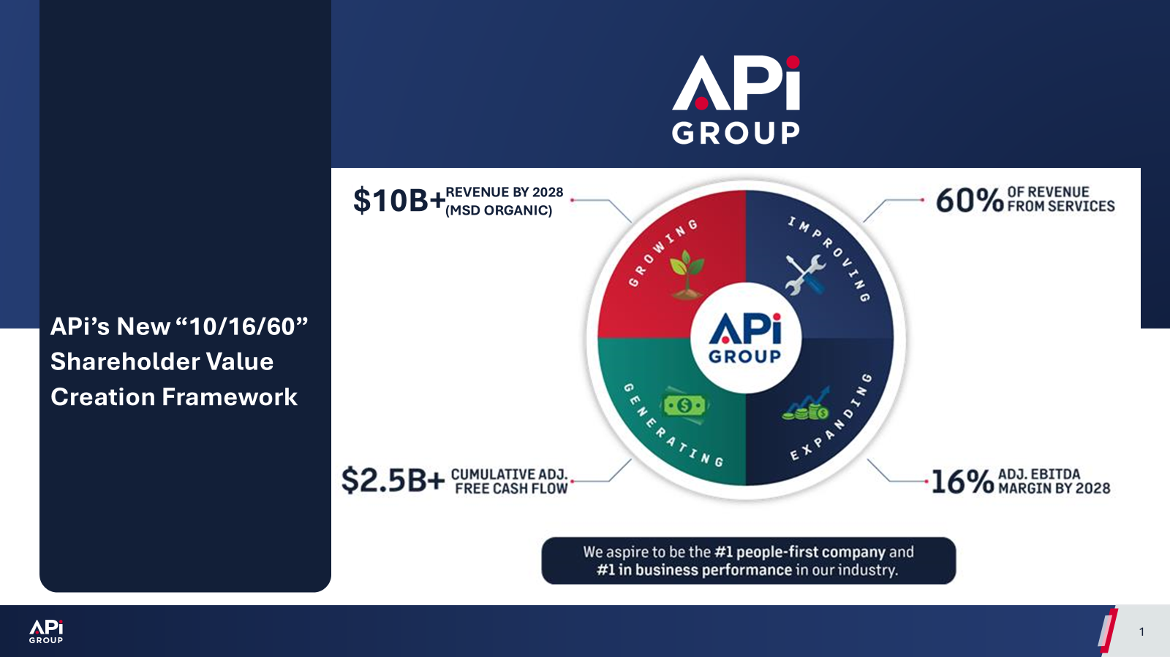
ALIGNING WITH API GROUP'S 2028 STRATEGIC GOALS
API Group's Strategic Goals
Supply Chain’s Core Strategic Role
Revenue Growth
Strength supply chain capabilities to drive regional business growth
Extend CCC sourcing capacity to support global joint-effort procurement activities.
Deliver agile support for service job ad-hoc material and service
EBITDA% increasing
Utilize CCC’s centralized sourcing model to consolidate regional demand, securing preferential pricing and improved commercial terms
Partner with manufacturers to cut out middle channel markups
Optimize logistics, warehousing and order-processing overheads to lift gross margin
Periodic supplier cost benchmarking to deliver long-term sustainable cost savings
Cash Flow Improvement
Negotiate favorable payment terms with top spend vendors
Accelerate inventory turnover and minimize work capital occupation

Slide 14
SUPPLY CHAIN OPERATION MODEL
Supply Chain Dept.
Management Takeaways
Strategic Rationale
Sourcing
Purchasing
Warehouse
Logistics
Clearer ownership across sourcing, purchasing, warehouse and logistics
Better segregation of duties and stronger process control
More scalable support model for future business growth
NEW
• Lead centralize sourcing activities in category based.
• Build up CCC supplier strategy
• Continuously cost optimization
• Streamline end to end order workflow efficiency
• Oversee order execution to ensure on time, in full and quality delivery
• Manage safety stock replenishment, improve inventory turnover.
• Maximize warehouse space utilization & drive lean operations.
• Maintain high inventory accuracy
• Optimize stock turnover to improve cash flow performance
• Managing logistics & 3PL partners to lift cross-border delivery efficiency.
• Accelerate customs clearance and shorten transit lead time.
• Optimize transportation spend for cost savings and better cash flow
Key Changes
Added a dedicated sourcing function
Separated strategic sourcing from purchasing execution
Simplified reporting lines and aligned roles by core capability
Expected Outcomes
Clear Functional Ownership, Operational Efficiency, Cost Optimization
Build a regional sourcing and supply chain hub, leveraging China’s supplier network to serve MCHM and broader markets with sustainable cost saving, full end to end process control, and reliable flexible supply capacity.

Slide 15
H1 2026 KEY INITIATIVES & PERFORMANCE METRICS
01 / Key Initiatives
02 / Key Performance Metrics
CCC Sourcing Team
Successfully built a dedicated regional strategic sourcing team to centralize decision-making and execution.
Mainland Factory Supplier Pool
Established a robust and competitive supplier pool from mainland factories to secure favorable pricing.
Key Metrics | 2026 Target | P6 YTD
Procurement cost saving | $3.3M cost saving/$2.6M cost avoidance | $0.2M cost saving/$1.9M cost avoidance
Payment term(Top vendors 80% of total spend) | ≥ EOM 60 days | EOM 46 days
PR convert PO SLA | ≤ 3 days | 1.5 days
General stock on time delivery | ≥ 85% | 80%
Slow-moving inventory | ≤ 34% | 37%
Unified Procurement Operation
Standardizing procurement operation workflows across MCHM
CCC Catalog Item Master Development
Initiated build up CCC catalog items to standardize material selection across regions and consolidate project demand for better pricing.
Cross-border Material Delivery Operation
Roll out standardized cross-boarder delivery process, develop long term partnership with 3PL to optimizing logistics efficiency
CCC central sourcing model build-up
Build the foundation with standardized workflows, clear resource allocation and cross region/BU cost alignment to unlock sustainable long term cost saving
Supply chain key objectives are set for driving EBITDA improvement and optimize working capital efficiency

Slide 16
H2 2026 ACTION PLAN & FOCUS AREAS
01
Drive Cost Savings LE US$1.4M
CCC central sourcing $0.35M
PO level negotiated cost saving $0.5M
Rebate negotiation $0.55M
04
Strengthen Supplier Performance
Build standardized supplier KPI evaluation framework covering on-time delivery, product quality, cost competitiveness and compliance.
02
Payment Term Improvement
Current 46 type diff. payment terms across MCHM, standardize into 9 types for top vendors and new vendors
Extend payment terms to meeting EOM+60 days for top vendors.
05
Global Procurement Initiatives
Global fire extinguisher tender
CCTV – Strategy partnership development with Hikvision, joint central sourcing with France and UK team.
CCC local supports for global China based suppliers.
System Implementation (GEP)
GEP source to contract system roll out to standardize sourcing workflows and enhance data visibility.
03
Optimize Logistics Strategy
Partner with specialized 3PL cross border delivery. Guangdong-HK-Macau route 1~2 days door to door delivery.
Continuously optimize cross-boarder transport routing to drive sustained reduction of total landed cost.
06

Slide 17
CCC CENTRAL SOURCING HUB
Core Positioning
CCC acts as the unified efficiency-driven procurement engine for MCHM. Managing internal/external collaboration consolidated cross regional material demands to deliver solid financial and operational results.
Business Regions
Sourcing Hub (CCC)
Factories
The core coordinator that aggregates, standardizes, negotiates and manages the full supply chain lifecycle between regions and factories.
Combine scattered material demand from all MCHM sites to form bulk orders and negotiate better pricing.
Manage all qualified mainland factory suppliers throughout their cooperation lifecycle
Unify quality checks, compliance control and cross-border delivery arrangements
Serve as one single contact window to cut duplicated communication between project teams and suppliers.
Submit full project material demand for centralized purchasing
Handover project material spec. & demand forecasts to CCC
Confirm local compliance rules, on-site delivery timeline and quality acceptance criteria
Fulfill consolidated bulk orders in competitive price, ensure all materials are delivered on schedule, with full order quantity and consistent agree quality standard.
Produce combined bulk orders directly to remove extra markup from middle distributors and cut material cost
Reserve stable, scalable production capacity to match MCHM’s demand.
Manufacture goods following CCC unified quality standards.

Slide 18
STRATEGIC VALUE
The CCC centralized sourcing model delivers scalable benefits for the broader organization
Cost & Margin
Operational Consistency
Leverages scale to optimize costs and improve project profitability, especially for small-to-medium projects, ensuring financial efficiency across the procurement lifecycle.
Standardizes processes across teams and regions, ensuring strict governance compliance and predictable, high-quality outcomes for all procurement-related activities.
Replicable Best Practice
Collaboration & Growth
Serves as a China-based benchmark for procurement excellence, establishing a proven framework with strong potential for adaptation and global adoption across markets.
Strengthens cross-functional alignment between procurement and business units, while building capabilities that directly support the development of future global category strategies.

Slide 19
KEY TRADE-OFF CENTRAL VS. LOCAL SOURCING
Local procurement
✅ Core Strengths
Flexibility: Low MOQ, adjustable order volumes & short local transit lead time for urgent, volatile demands.
Cash Flow: Distributors pre-hold stock, no upfront inventory investment costs.
Local Support: Fast response.
❌ Inherent Limitations
Higher Cost: Distributor/middle channel markup and less bargaining power.
Intransparency: Limited upstream supply chain visibility, lack of cost and quality control
CCC Centralized Sourcing
✅ Long-Term Strategic Upsides
Cost Reduction: Material cost reduction via consolidated cross-region bulk purchasing, sustaining EBITDA margin growth
Standardization: Unified Item Master, specs, and global quality control.
Transparency: Direct manufacturer partnership delivers full upstream cost & production transparency
⚠️ Short-Term Operational Trade-offs
MOQ: Factory MOQ rules limit agility for small, ad-hoc orders.
Longer Lead Time: Extended production and cross-border transit.
Cash Flow Pressure: Upfront bulk stock investment creates temporary working capital pressure.
Local procurement delivers maximum operational flexibility and minimal short-term cash pressure, yet sacrifices long-term cost competitiveness and unified supply chain governance.
CCC centralized sourcing unlocks sustainable margin improvement and standardized operations, but comes with short-term constraints on order agility and working capital.

Slide 20
BALANCED MITIGATION SOLUTIONS
01
Optimize Payment Terms
02
Shorten Logistics Lead Time
03
Enhance Demand Forecast
Negotiate longer payment terms with direct manufacturers to ease cash flow pressure from bulk procurement.
Adopt dedicated cross-border logistics solutions for Guangdong-HK-Macau routes, achieving 1-2 days site transit.
PMs to deliver more precise material forecasts and timelines in advance to adapt to fixed manufacturing cycles.
04
Build CCC Material Catalog
05
Adopt Dual Sourcing Model
Establish a standardized CCC material catalog, reduce customized items to support consolidated procurement and lower inventory risk.
•Centralized: For cross-project universal standard materials.
•Local: Retain distributors for small-batch custom parts and on-site emergencies.

Slide 21
CCC CENTRAL SOURCING ROADMAP
Short Term (2026)
Mid-Term (2027)
Long Term (2028)
Build Foundation & Validate Model in CCC
Scale Collaboration with API International
Mature CCC Sourcing Hub for API Group
Identify & Pilot: Select and pilot the first wave of high-potential categories for regional centralized sourcing.
Supplier Development: Identify and onboard key suppliers with strong Mainland China supply chain advantages.
Process Establishment: Build foundational operational processes for centralized sourcing and compliance.
Quick Wins: Achieve initial cost savings and efficiency improvements.
1. Local China Execution Support: Act as the dedicated onshore China team to assist global procurement teams for China-based supplier management
2. Shared Group Operational Resources: Provide our verified standard workflows for sourcing, quality engineering and cross-border logistics as group shared resource.
3. Reliable Long-Term China Supply Pool: Serve as API’s key long-term supply solution for EBITDA and working capital optimization.
1. Expand Scope: Significantly expand the range of commodities under centralized sourcing.
2. Centralize Execution: Achieve full centralized order management for all categories across MCHM.
3. Global Collaboration: Replicate the validated model With API international regions to aggregate cross-market demand.
4. Grow CCC Expertise: Upskill CCC team to focus on strategic sourcing work, robust local capacity to support more regions sourcing activities.
Core Objectives:
Build and test our centralized sourcing model within MCHM to deliver measurable cost savings. Then mature our China-based hub as a shared group resource to support API intel procurement activities.
Creating long term sustainable cost benefits for the whole API Group.

Slide 22
GLOBAL & CCC SOURCING COLLABORATION OUTLOOK
CCC-Led Centralization
High Repeat Standard Items
Global-Led Partnerships
Strategic Branded Equipment
Retained Local Flexibility
Customized & Localized Needs
Scope: General fire safety equipment & accessories, general electronics security equipment, office supplies and PPEs.
Scope: Negotiate best level pricing & commercial terms via API intel partnerships for global OEMs
Scope: Highly customized project materials tailored to unique site requirements, and local subcontract services for on site execution.
Rationale: Leverage China's manufacturing strength and cost advantage for high-volume, standardized items. CCC manages the entire sourcing cycle.
Rationale: Global Procurement leads strategic negotiations with principals. CCC executes regionally, ensuring compliance and local optimization.
Rationale: Maintain agility and responsiveness to address unique project specs and adapt quickly to local market dynamics and regulations.

Slide 23
OPERATIONS
Henry Iong

Slide 24
STRUCTURED APPROACH TO IDENTIFY PROCESSES FOR CCC MIGRATION
放假
Steps for Process Identification
Process Identified for 2026
BIM / CAD *
Estimation for Tender
Drawing
1
Study business pain points and process challenges
Assess CCC support feasibility and value potential
Confirm project objectives, stakeholders, and success criteria
Order Creation - SV *
Business Process Support
Project Launch
Order Creation - SN*
Establish a cross-functional project committee
Define governance, roles, responsibilities, and escalation path
Set communication cadence and progress tracking mechanism
2
Project Committee Setup
PR Preparation*
SV Billing*
3
Scope Identification
Map current process scope, ownership, and handoffs
Define in-scope / out-of-scope CCC support activities
Identify required skills, access, compliance needs, and dependencies
Deposit Billing*
Contract Approval Request
4
Process Prioritization
Identify and prioritize candidate processes for migration
Validate complexity, readiness, controls, and compliance impact
Confirm first-phase process list and target KPIs
Cost Adjustment
Payment Application*
5
Go-Live Readiness and KPI Tracking
Define go-live timeline, migration waves, and milestones
Complete knowledge transfer, SOPs, training, and system readiness
Track post-go-live KPIs
Service App & Report
Engineer/Project Documents*
Engineering Support
This structured approach enables smoother migration, stronger collaboration, and more consistent CCC service delivery.
Go Live in CCC
In Process
* Original Plan
24

Slide 25

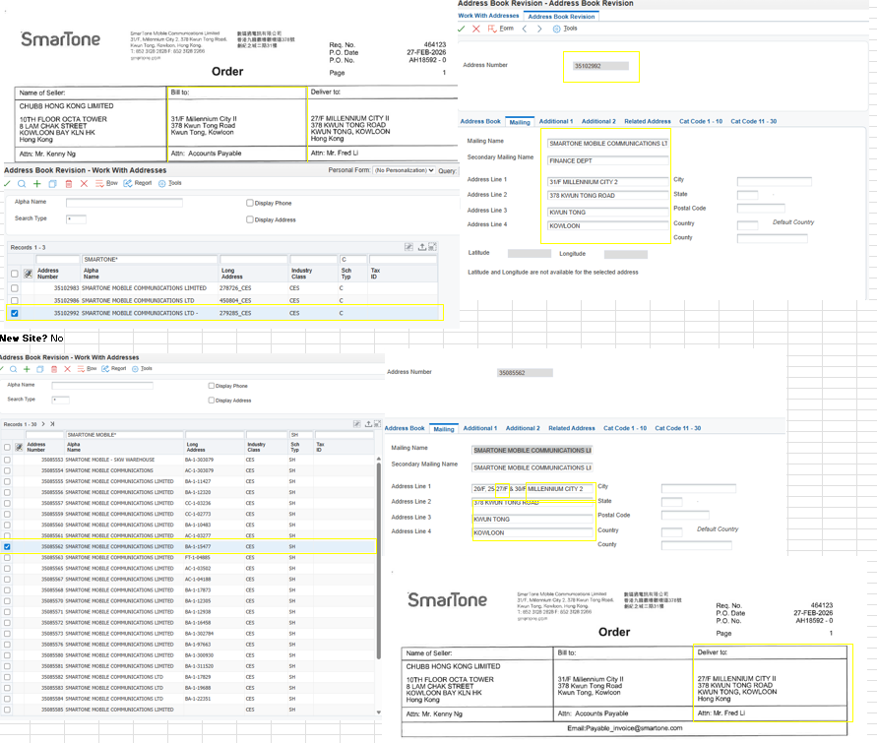
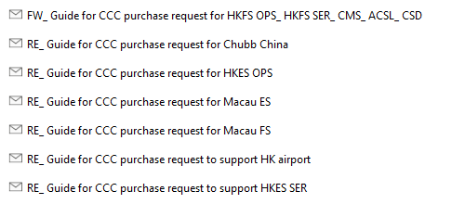

CCC PROCESS COMPLIANCE
Step 1
Step 2
Step 3
Step 4
Step 5
Step 6
Alignment
Sox Review
System Role Review
Sample Run
Training
Go Live
Align with Process owner, Local BU and other region (non-tier A).
Controller SOX review after alignment to ensure compliance.
System role need to have SOD review by Finance and BU and then have technical discussion with IT.
Try to demo the process handle by CCC to ensure feasible and compliance.
Training provide by local BU, after training will have around 2 weeks job shadowing period. Local BU will keep check the input.
CCC can fully handle the process smoothly.
Process Transfer Status
Process / Steps | Alignment | Sox review | System role review | Sample Run | Training | Go Live
Order Creation-SV | ✔ | ✔ | ✔ | ✔ | ✔ | ✔
PR preparation | ✔ | ✔ | ✔ | ✔ | ✔ | ✔
Order Creation-SN | ✔ | ✔ | ✔ | ✔ | ✔ | ✔
Deposit Billing | ✔ | ✔ | ✔
SV Billing | ✔
Sample of process transfer flow record

Slide 26
CCC OPERATIONS CENTRAL PROCESS EXECUTION
Improving Accuracy, Consistency and Efficiency
Before CCC
After CCC
Process handled differently by each BU / local team.
Request information and supporting documents vary by person
Local staff spend time on repetitive admin tasks
Status tracking depends on emails and manual follow-up
Higher dependency on individual knowledge
Harder to monitor SLA and backlog consistently
Standard request intake and checklist
Dedicated CCC team handles repeatable execution
Ticket / SharePoint workflow improves visibility
SLA and accuracy are tracked centrally
Mutual backup reduces single-person dependency
Local teams focus on higher-value business activities

Slide 27
KEY LEVERS TO IMPROVE OPERATIONAL EFFICIENCY
CCC is improving operational efficiency through automation, standardization, digital tools, and stronger collaboration across teams.
Ticket Automation
Paperless Process
04
01
Digitize and automate ticket intake, tracking, and closure to improve visibility and reduce manual follow-up.
Enable paperless document storage and transfer through approved cloud-based platforms to improve accessibility and control.
02
Service Delivery Improvement
Communication Channels
05
Optimize service workflows and coordination to improve responsiveness, consistency, and SLA performance.
Strengthen cross-team communication channels to improve issue resolution, alignment, and service responsiveness.
Process Standardization
06
03
Leverage Tools
Use digital tools to reduce manual effort, improve productivity, and support tender-related analysis or item counting.
Standardize and centralize processes to improve consistency, control, and scalability across teams.

Slide 28
2026P6YTD PERFORMANCE METRICS – ORDER CREATION
Order Received
5,378
Order Processed
5,284
Contract Amount
USD 4.21M
Internal Order Accuracy
96.35%
SLA %
92.3%
Requests by BU
Handled By CCC %
Process Time (Mins)
Target: 76 mins
Target: 25 mins
SLA% review：
Accuracy review：
Opportunity：
Efficiency：
Waiting time for process
Credit hold
Waiting manager approval
System interface lead time
Error for attachment information input
Diversified document requirement
Centralization handing help to improve standardization
Alignment of high standard SOX requirement for non-tier A region
Through SharePoint and ticket system to transfer document
New Ticket system reduce process time
28

Slide 29
2026P6YTD PERFORMANCE METRICS – PR PREPARATION
Order Received
324
Order Processed
322
Request In Progress
22
Internal Order Accuracy
91.5%
SLA %
92.1%
Requests by BU
Handled By CCC %
Process Time by Request (Mins)
Forecast
Target: 8
SLA% review：
Accuracy review：
Opportunity：
Efficiency：
Waiting time for process
Waiting manager approval
Error information input
Items code selection
Centralization handing help to improve standardization
Through SharePoint and ticket system to transfer document
Dedicated personnel handle PR requests
29

Slide 30
2026P6YTD PERFORMANCE METRICS – DRAWING
Request Received
566
Request Processed
555
Request In Progress
11
Drawing Numbers
4,923 (P3-P6YTD data only)
SLA %
98.4
Requests by BU
Handled by CCC%
Forecast
Diversified support
Challenges
Opportunities
Solutions
Provide BIM, CAD, Drawing exporting, Standard design(MO, CN) , tender support (Counting)
Difficult to allocate sufficient manpower during peak seasons, while staffing tends to be excessive during off-peak seasons.
Provide training in off-peak seasons to improve skills.
Provide cross function of backup for engineer support
Maintain outsource resource for peak seasons
Flexible working hour

Slide 31
CHALLENGES & SOLUTIONS
Challenges
Solutions
！
Seasonal manpower imbalance
Prioritize request handling
Manpower is insufficient during peak seasons, while resources may be underutilized during off-peak periods.
Apply a priority-based approach to manage requests more effectively, especially during peak periods, to ensure urgent cases are handled first.
Enhance training and local communication
！
Complexity of the SN process
The SN process requires a higher level of knowledge and experience, making it challenging for CCC assistants to manage smoothly.
Provide additional training and encourage proactive discussions with local teams to better understand operational issues and identify process bottlenecks.
Assign dedicated personnel for specific processes
！
Transition time for new processes
Newly transferred processes require sufficient training, adaptation time, and workflow adjustment before CCC can handle them efficiently.
Assign dedicated staff to handle the same process consistently to build expertise, improve efficiency, and facilitate knowledge sharing with other team members.

Slide 32
FINANCE
Amy Shi

Slide 33


CCC FINANCE POSITIONING
What are we trying to become?
Where are we today?
How do we get there and sustain the model?
01
REGIONAL PROCESS EXCELLENCE HUB
• Align SOP, SLA, control points with global expectations | • Reduce local variations where practical | • Build auditable, repeatable documentation
• Maintain clear regional scope, consistent approval workflow | • Strengthen inter-company cost allocation and TP compliance | • Identify automation opportunities
02
RELIABLE MULTI-ENTITY FINANCE OPERATING MODEL
• Support 11 legal entities across three regions under one operating rhythm
• Build clear ownership, backup coverage and service transparency | • Improve process stability, timeliness and accuracy across the region
03
VALUE-ADDED FINANCE CAPABILITY
• Expand into project accounting and forecasting | • Support better cashflow visibility and decision-making
• Improve TAT / turnaround time | • Use KPI insights to identify business improvement opportunities | • Drive efficiency through standardized ways of working
Do HK / Macau / China better, improve efficiency through standardized processes and KPI governance, and build value-added Finance capability within regional scope.

Slide 34
CURRENT FINANCE SCOPE & STANDARDIZATION STATUS
# Processes
2026 Planned
Already Live in CCC
2026 In Progress
2026 Opportunities
9
7
2
2
R2R incl. FP&A 3/4
P2P 3/4
O2C 1/3
Already live in CCC
Monthly/Quarterly/Yearly Accounts Reconciliation
Monthly Asset Depreciation
Monthly Journal Entries (Recur. Journal ~300 per month)
2026 in Progress
FP&A reporting
Already live in CCC
Concur Review – Staff Claims
Voucher Matching (PO)
Voucher Matching (SubCon)
2026 Opportunities
Payment process including Online Approval (AP process improvement)
Already live in CCC
Reporting OTC09
2026 in Progress
AR settlement process / DSO improvement (Blackline)
2026 Opportunities
Project Accounting, Forecasting & OTC10 support
Global process alignment lens for each process
Each process is moved as a combined HK / Macau / Mainland China scope, with common SOP, controls and governance wherever practical.

Slide 35
PROCESS ALIGNMENT PLAYBOOK
BEFORE - Prepare
DURING - Execute
AFTER - Review
1
Practice Sharing
Map current processes across HK, Macau and China entities
4
Align & Approve
Align SOP with global process owners, validate key controls with internal / external auditors.
7
3rd Month Go-Live Maturity Review
Stabilization check: volume, quality, timeliness, turn-back rate
2
Compare & Reduce Variance
Identify commonality and variations
5
Train & Transition
Shadowing, access setup, issue log and backup coverage
8
5th -6th Month Efficiency Review
Identify automation, simplification and scale opportunities
3
Standardize SOP
Unified SOP, timeline, control points, RACI, and documentation
6
Go-Live
CCC takes ownership under agreed SLA
9
Feedback to Next Cycle
Lessons learned inform the next process alignment iteration
Continuous Improvement Cycle → feeds into next process alignment
Core principle: Start with practice sharing, reduce variance through standardization, execute with discipline, and close the loop with efficiency review.
Examples. Concur – standardized policy and fully paperless submission
Invoice Match Voucher – vendor education, standardized submission and paperless review process
Account Reconciliation – align Tier 3 entities with Tier 1 control standards

Slide 36
FINANCE CAPABILITY MATURITY JOURNEY
Building process stability first, then transaction expertise, and continuously optimizing with GCC.
Past 9 months
Stabilize Standard Finance Processes
Stabilize migrated processes under CCC ownership and BAU model
Build consistent SOP, SLA, control points and documentation
Improve visibility across TAT, accuracy, quality and internal control
Process Stability
Stable operations with clearer governance, ownership and process visibility
10–18 months
Build Transaction Expertise
Deepen expertise across migrated processes
Improve TAT, accuracy and first-time-right execution
Identify automation and simplification opportunities
Efficiency Improvement
Higher efficiency through KPI governance, standardization and process discipline
>18 months
Evaluate, Optimize and Refine with GCC
Review process maturity and regional comparability with GCC
Continue improving controls, governance and process efficiency
Expand proven practices across HK, Macau and Mainland China
Continuous Improvement
Continuous optimization through governance, review cycles and GCC collaboration

Slide 37
PERFORMANCE BY PROCESS DOMAIN: HOW WE MEASURE
CCC Finance tracks TAT and Accuracy across O2C, P2P, R2R and FP&A to drive measurable improvement.
R2R
P2P
O2C
FP&A
Record-to-Report
Procure-to-Pay
Order-to-Cash
Financial Planning & Analysis
Key Activities
• Account reconciliations (before day 20)
• Recur. journals & asset depreciation (Before C1)
• OTC09 / OTC10 reporting (1st week of month)
• Rolling forecast & review deck (before MMU)
Key Activities
• AP voucher matching-PO / SubCon (24 hrs)
• Concur review (staff claims) (5 working days)
• Payment process with online approval
Key Activities
• Cash application via Blackline
• Project accounting & forecasting
Key Activities
• Management reporting (M/Q)
• Budget vs. actual analysis
• Entity-level P&L visibility
• Support regional leadership decisions
TAT: meet ddl 98% / 100%
Accuracy: 95% / 100%
Improvement Focus: Close discipline & control quality
TAT: Voucher Matching within 24 hrs
Accuracy: 95% / 95%
Improvement Focus: Reduce rework, increase review efficiency (raise 1st time invoice match rate)
TAT: TBC (align with GCC)
Accuracy: TBC (align with GCC)
TAT: Report on time
Delivery: decision-making support
Governance Rhythm:
Weekly: Volume & exception review
CCC Finance Team
Bi-weekly: Transformation Progress Review
Finance Transformation Committee Team
Monthly/Quarterly: Quality & Efficiency Review
Regional Key Finance Stakeholders
Annually: SLA / Control / SOX Review
Controller / Auditor

Slide 38
Regional Service Excellence: HK, Macau & Mainland China
Keep improving what we have migrated, remove friction points, and turn process discipline into business value.
What We Will Strengthen
What Must Be in Place
How to Progress
Improve cross-region communication and transparency through better timeliness and accuracy
Reduce avoidable process differences across 11 legal entities and three regions
Strengthen quality, internal control and first-time-right execution
Enhance KPI governance to make performance visible and actionable
Reduce heavy reliance on paper-based documents and move toward electronic workflow
Improve document filing quality, completeness and retrievability
Ensure clear ownership, system access and approval alignment before process changes
Maintain required localization only where regulation, tax, system or business needs require it
Review SLA annually to respond to changing or new business models
Use KPI governance to identify bottlenecks and efficiency improvement opportunities
Conduct regular process reviews after migration to stabilize, improve and simplify
Keep building regional playbooks while aligning with global process expectations
Our goal: a controlled, standardized and value-added regional Finance capability
— delivering stronger transparency, better control, higher efficiency and more value-added support

Slide 39
SOLUTIONS
Kevin Lam

Slide 40
CCC SOLUTIONS TEAM - OBJECTIVES
Improve Solution Development Efficiency
Support faster rollout of business solutions by improving development responsiveness, reducing handoff delays, and aligning more closely with business needs.
Create Business Values
Building In-house Development Capability
Create business value by enabling new business models through modular platform capabilities and by reducing external dependency, improving both growth support and cost efficiency.
Develop internal expertise in software development, keep all knowhow inside Chubb
Objectives

Slide 41
CCC SOLUTIONS TEAM CAPABILITY
Solution Development
UI/UX Design
Quality Assurance & Testing
Confirm adopting company standard and requirement
Validate solution quality before release
Define testing standards and acceptance criteria
Create test reports and testing procedures
Enhance and maintain the solution
Develop web-based and mobile applications
Support application deployment and ongoing maintenance
Design solution graphics and user interface concepts
Develop application storyboards and user journeys
Enhance user experience and usability
Together, these capabilities enable CCC to support end-to-end solution delivery — from design and development to testing, deployment, and maintenance.

Slide 42
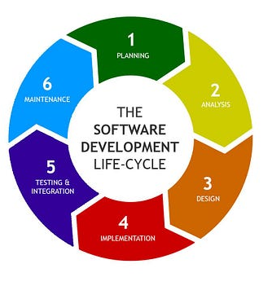
CROSS-BU COLLABARATION AND DELIVERY WORKFLOW
We (CCC, business unit, and project stakeholders) work together to transform identified requirements into implemented solutions through a structured end-to-end workflow.
Cross BU Collaboration Model
Business Unit
Market Driven
Identify Needs
Define Priorities
Stakeholders
Align Requirements
Validate Priorities
Project Planning
CCC Team
Design Solution
Execute Delivery
Train local support team
Stakeholders
Project review
Collect Customer Satisfaction
Arrange customer training
CCC Solution team engage in the whole development cycle:
Project planning
Requirement Analysis
System Design
Development
Testing & Integration
Maintenance and review
Global SDLC Guideline

Slide 43
CONSISTENT STANDARDS ON SOFTWARE DEVELOPMENT
Secure by design
Architecture Governance
Focus on embedding security from the beginning of the solution lifecycle.
Integrate security considerations early in solution design
Apply secure architecture principles across development initiatives
Reduce downstream risk through proactive design controls.
Focus on consistency, scalability, and alignment.
Establish architecture standards and solution design guardrails
Ensure alignment with enterprise technology and security requirements
Improve design consistency across initiatives and regions.
Consistent Standards
Focus on disciplined build practices and delivery quality.
Standardize development practices, documentation, and review controls
Promote reusable patterns and consistent engineering approaches
Improve code quality, maintainability, and delivery discipline
Focus on long-term internal capability.
Strengthen internal knowledge in architecture and engineering practices
Build team awareness of security and technical standards
Reduce dependency on ad hoc or inconsistent delivery methods
Engineering Standards
Sustainable Capability Building

Slide 44
ROADMAP 2026 – DRIVE NEW BUSINESS MODEL
(Q4) Logistic Module
Nov
Jan
(Q1) License Module (100%)
QR Code payment server and ATL Mobile App
System architecture redesign
System stability
License Module
(Q4) Car Park Module
Oct
Integrate with ACS car part software SC2000
(Q1) Access Control Solution Enhancement (100%)
Mar
Digital IO board expansion (IO6 / IO16)
Controller auto-scan
Interlock
Attendance report
Octopus
(Q4) IoT Module (MQTT protocol)
Sep
Modular Platform Development
Compatible with Milesight IoT Gateway with Door sensor, water leakage sensor and IAQ sensor
(Q2) Remote Diagnostic Module (90%, Complete in June)
(Q3) Access Control Solution Enhancement
Apr
Remote Diagnostic data set is ready
Server and controller status is ready for diagnostic
Defined notification criteria for the alert
Notification sent by SMS and email for on-prem environment
Aug
Elevator control
Anti passback (Phase 2)
Event and Alarm digital output logic
Controller webpage
(Q2) Access Control Solution Enhancement (70%, Complete in June)
(Q3) Alarm Notification Module
Jul
May
Compatible with existing burglar alarm panel. fire alarm panel (Honeywell / Edwards)
License generation portal
Dual Authentication
Card Printing
iAM Smart
Anti passback (Phase 1)
Notes:
Project based→ Modular/ Standard version

Slide 45
LONG TERM PLANNING
Optimization and Modernization Short Term | Transformation and Innovation Mid to Long Term
Establish an API set for other systems to integrate with Chubb System | Move forward to platform-based (ACaaS) solution delivery
Integrate with other subsystem to become a turkey solution, such as Hikvision / Axis / Bosch / HID | Build enterprise-level integration and data capabilities
Including AI elements in our solution – chat-bot & voice-bot / video analytics | Expand use of AI Solution – intelligent automation
Robot integration – AMRs for logistic center | Expand use of Robot Solution – virtual guarding, service robot in Hotel and Hospitality
8
10
12
15
People Resource
2027
PM & Technical support
2028
Systems Engineer
2029
AI Algo Engineer
2030

Slide 46
BUSINESS OPPORTUNITIES
Project Name | Status | Contract Value (USD)
GCC HR system integration | Done | 1,500
BOC insurance | Done | 3,000
Nomura Research Institute | Done | 1,200
Menzies CNAC – Cloud-based Studio | Order placed | 80,000
CSD – People searching system | Order pending | 1,200,000
Hogan Lovells | Order placed | 15,000
Zurich Insurance | Quoted, successful rate >90% | 36,000
Europe Watch Company | Quoted, successful rate >90% | 20,000
Jean Marie Pharmacal Medical factory | Proposed
New Town Plaza phase 3 | Proposed
Housing Authority | Proposed
UPS | Proposed
SmarTone | Proposed
 | Total | 1,356,700 (GP ~$480k)
Notes:
Start from CCC establishment from last Oct

Slide 47
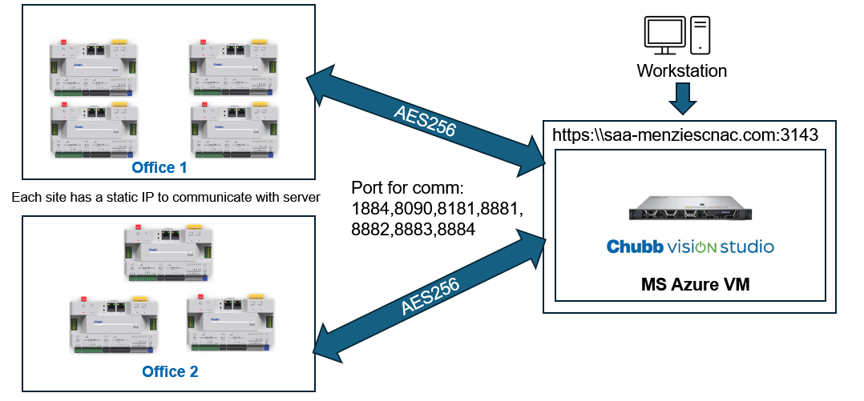
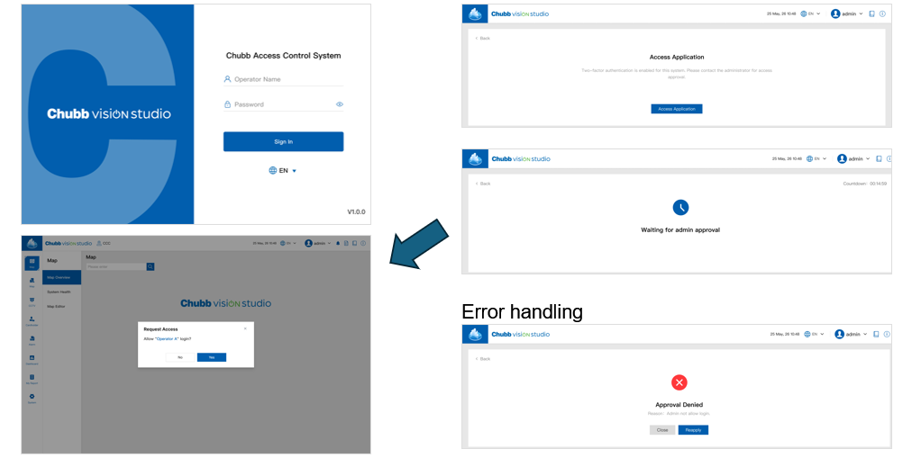

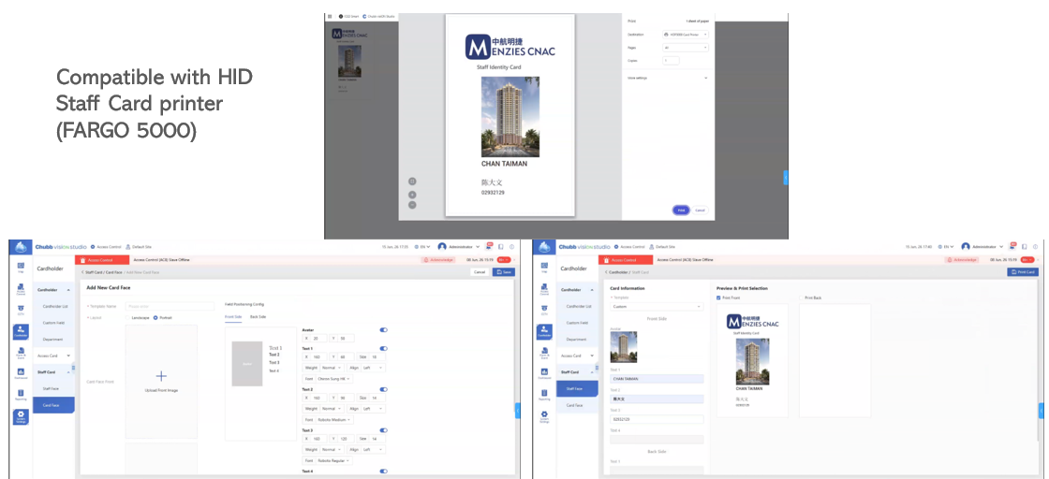
BUSINESS CASE - Menzies CNAC
Network Set-up
Multi-sites Connections
IP Communication
DUAL AUTHORIZATION
Cloud Based
STAFF CARD PRINTING MODULE

Slide 48
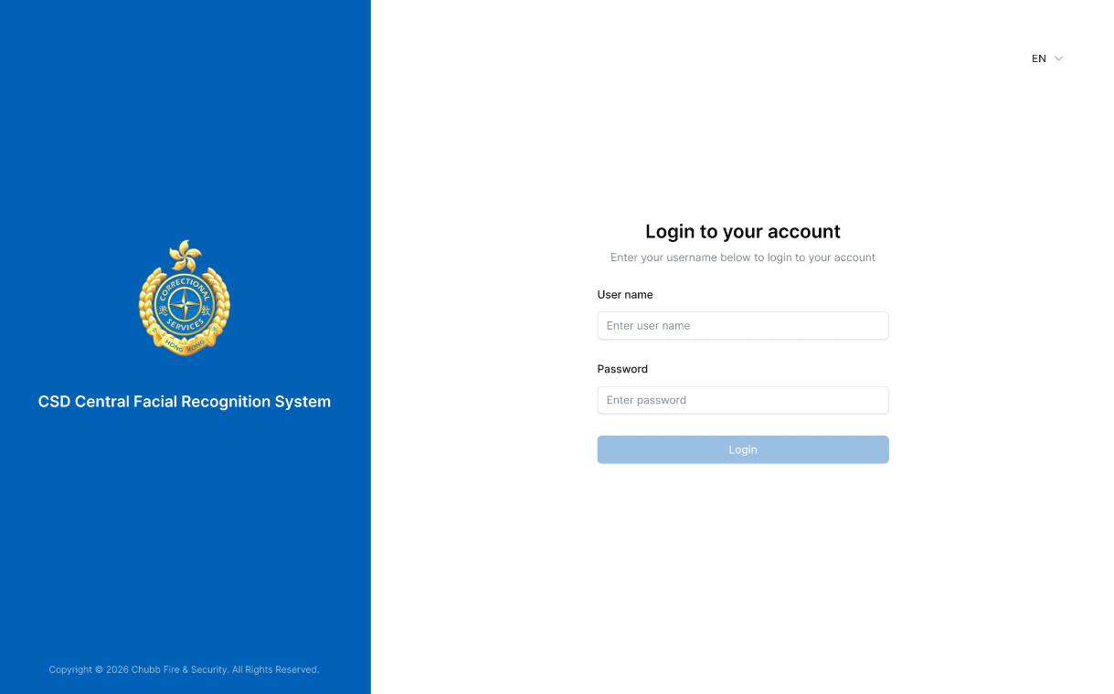
BUSINESS CASE - CSD PROJECT
Project Background:
Customer:
CSD
Functionality requirements:
Establish a prisoner facial recognition system based on the existing CCTV in the prison.
Timeline:
Complete in Sept 2026
Notes:
Customer driven project

Slide 49
THANK YOU

