Slide 1
MCHKM Service
Performance Report –
China Capability Center
Mar 2026

Slide 2
APR YTD Performance Metrics – finance
Total Recon
528
Total Concur
513
Total 3-way Match
832
Recon Accuracy
97%
Recon SLA %
97%
Reconciliation by region
Concur by region
Timely Completion for Recon
Summary:
Q1 scope covers HMC in recon & concur,
Total average manpower: 3.3 HCs
Target 3-way match completion day: 7 working days / invoice
Reconciliation complete before every 20th of the month
Concur review: 5 working days

Slide 3
AGENDA
ACTION ITEMS
INCIDENT LOG
INCIDENT
OPERATION & CLOSING EVENTS
ENTITY SUMMARY
RECORD TO REPORT
Highlights & Challenges
Business Outcome Indicators
Balance Sheet Reconciliations
Bs Reconciliation Rejection/Decertification Reason
MJE Closing Status
ARMS REJECT ACCOUNT STATUS TRACKING
RTR / IC Volume
Purchase TO PAY
Highlights & Challenges
Business Outcome Indicators
Invoice Discrepancy Trend
PO & NON PO Volume
Invoice Discrepancy
Payments
Inquiry & Urgent Payment
T&E Volume Processing
T&E Discrepancy Reason / $ USD
FP&A
INNOVATION / AUTOMATION
ORDER TO CASH
Highlights & Challenges
Business Outcome Indicators
OTC 09 & OTC 10
APPENDIX
SLA’S / KPI’S
Regional Attendees | CCC Attendees
Annie
Ming Lau
Carrie
Cindy Chiang
Mona
Amy Shi
Yannis Zeng
Zoe Xie
Ella Li
Eva Tan
Winnie Li

Slide 4
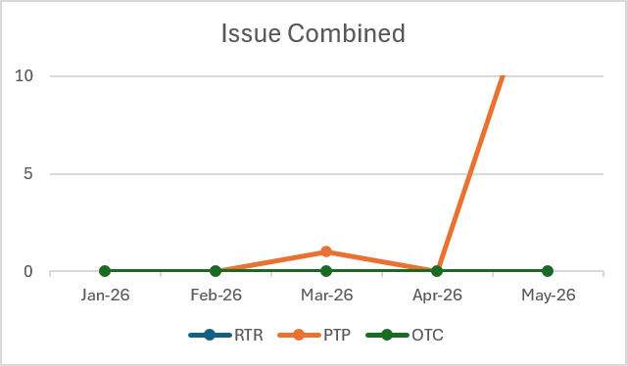
INCIDENT LOG
New Issues for Month |  |  |  |  |  |  |  | Closed Items for Month |  |  |  | Summary
Entities | RTR | Criticality | PTP | Criticality | OTC | Criticality | Total | RTR | PTP | OTC | Total | Carry Forward | New | Closed | Outstanding
ACS | 0 |  | 0 |  | 0 |  | 0 | 0 | 0 | 0 | 0 | 0 | 0 | 0 | 0
CCHL | 0 |  | 0 |  | 0 |  | 0 | 0 | 0 | 0 | 0 | 0 | 0 | 0 | 0
HK | 0 |  | 0 |  | 0 |  | 0 | 0 | 0 | 0 | 0 | 0 | 0 | 0 | 0
Taiwan | 0 |  | 0 |  | 0 |  | 0 | 0 | 0 | 0 | 0 | 0 | 0 | 0 | 0
Macau | 0 |  | 0 |  | 0 |  | 0 | 0 | 0 | 0 | 0 | 0 | 0 | 0 | 0
China | 0 |  | 17 |  | 0 |  | 1 | 0 | 0 | 0 | 0 | 0 | 0 | 0 | 0
Total | 0 |  | 17 |  | 0 |  | 1 | 0 | 0 | 0 | 0 | 0 | 0 | 0 | 0

Slide 5
INCIDENT & ISSUE
BU | Volume | Criticality | Description | Impact | Who Found | Repeat within current year | Root Cause(s) | Preventive Action Plan
China | 17 | High | This month, a significant discrepancy was identified during the three-way matching process for OS. Upon investigation, it was found that, as OS payments are recognized based on progress, only the amounts were adjusted proportionally during the matching process, while the corresponding quantities were not updated accordingly. | CNY 98,360.39（(The data excludes discrepancies of less than 1.) | Senior Finance Manager | May-26 | 1.During the three-way matching process, insufficient attention was given to verifying whether the quantities were consistent with the amounts. 2.After completing the three-way matching, no further review was performed to confirm whether any discrepancies remained. | During the three-way matching process, greater care is required to verify that quantities and amounts are adjusted proportionally and consistently. Upon completion, a systematic review should be performed to ensure that no discrepancies remain.

Slide 6
RECORD TO REPORT

Slide 7
RECORD TO REPORT
Record to Report Indicators
BOI | Target | Jan-26 | Feb-26 | Mar-26 | Apr-26 | May-26 | Jun-26 | Jul-26 | Aug-26 | Sep-26 | Oct-26 | Nov-26 | Dec-26 | Volume change vs. last month
Reconciliation Accounts (#) -O/S | N/A | 105 | 98 | 224 | 101 | 101 |  |  |  |  |  |  |  | -123
HK |  | 45 | 45 | 120 | 45 | 45 |  |  |  |  |  |  |  | -75
Macau |  | 14 | 14 | 28 | 14 | 14 |  |  |  |  |  |  |  | -14
China |  | 46 | 39 | 76 | 42 | 42 |  |  |  |  |  |  |  | -34
Reconciliation Accounts (#) -offline | N/A | 91 | 80 | 26 | 79 |  |  |  |  |  |  |  |  | 53
Account Reconciliation Timeliness% | 100% | 100% | 100% | 98% | 97% |  |  |  |  |  |  |  |  | 2%
HK | 100% | 100% | 100% | 97% | 89% |  |  |  |  |  |  |  |  | 3%
Macau | 100% | 100% | 100% | 100% | 100% |  |  |  |  |  |  |  |  | 0%
China | 100% | 100% | 100% | 96% | 100% |  |  |  |  |  |  |  |  | 4%
Account Reconciliation Turn Back# | N/A | 12 | 9 | 29 | 5 |  |  |  |  |  |  |  |  | -24
HK |  | 9 | 8 | 19 | 4 |  |  |  |  |  |  |  |  | -15
Macau |  | 2 | 0 | 3 | 1 |  |  |  |  |  |  |  |  | -2
China |  | 1 | 1 | 7 | 0 |  |  |  |  |  |  |  |  | -7
CCC
Timeliness decreased by 1% (from 97% to 98%) and not arrive target percentage 100% since have not aligned with regional staff 1st level approve deadline in OneStream. Will align 20th 1st level review timeline.

Slide 8
RECORD TO REPORT
Record to Report Indicators
BOI | Target | Jan-26 | Feb-26 | Mar-26 | Apr-26 | May-26 | Jun-26 | Jul-26 | Aug-26 | Sep-26 | Oct-26 | Nov-26 | Dec-26 | Volume change vs. last month
Journal Entries (#) (Include Depreciation) | N/A | 35 | 42 | 41 | 52 | 93 |  |  |  |  |  |  |  | 42
HK |  | 2 | 9 | 7 | 16 | 14 |  |  |  |  |  |  |  | -2
Macau |  | 0 | 0 | 1 | 0 | 23 |  |  |  |  |  |  |  | 23
China |  | 33 | 33 | 33 | 36 | 56 |  |  |  |  |  |  |  | 21
Journal Entries Accuracy% | 100% | 100% | 100% | 100% | 100% | 97% |  |  |  |  |  |  |  | -3%
HK | 100% | 100% | 100% | 100% | 100% | 100% |  |  |  |  |  |  |  | 0%
Macau | 100% | N/A | N/A | 100% | N/A | 95% |  |  |  |  |  |  |  | N/A
China | 100% | 100% | 100% | 100% | 100% | 95% |  |  |  |  |  |  |  | -5%
CCC
Journal entries accuracy decreased from 100% to 97% since duplicate booking, omitted booking, supporting mistaken. The corresponding journal entries have been corrected in current month.

Slide 9
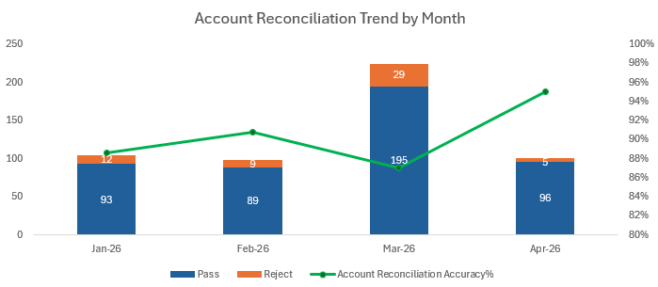
RECORD TO REPORT
BS Reconciliation Rejection
BU | Total GL a/c count | Loaded beyond 20th | Approved beyond 25th | Incorrect Supporting | Lack Supporting | Incorrect Item(s) | Lack item(s) | Missing detailed workings | Reconciliation balance doesn't tie with GL | Other | Total Rejected Accounts
ACS | 94 | 0 | 0 | 0 | 1 | 2 | 0 | 0 | 0 | 1 | 4
CCHL | 17 | 0 | 0 | 0 | 1 | 0 | 2 | 0 | 0 | 3 | 6
CHK | 130 | 0 | 0 | 3 | 0 | 12 | 2 | 1 | 0 | 9 | 27
Macau | 70 | 0 | 0 | 0 | 0 | 4 | 0 | 0 | 0 | 2 | 6
Taiwan | 14 | 0 | 0 | 1 | 0 | 0 | 0 | 0 | 0 | 2 | 3
Beijing | 98 | 0 | 0 | 0 | 1 | 0 | 1 | 0 | 0 | 3 | 5
Shanghai | 72 | 0 | 0 | 0 | 1 | 1 | 0 | 0 | 0 | 1 | 3
CCC | 33 | 0 | 0 | 0 | 0 | 0 | 0 | 0 | 0 | 1 | 1
 | 528 | 0 | 0 | 4 | 4 | 19 | 5 | 1 | 0 | 22 | 55
Reconciliation Period: Jan 26 - Apr 26
Total number of Reconciliation : 528
      Reconciliation Completed : 528
      Reconciliation Rejected : 0
      System certificated : 61
      Reconciliation Approved :
      Reconciliation Submitted : 467
      Reconciliation in progress : 0

Slide 10
RECORD TO REPORT
Highlights
Challenges
CCC
Any account reconciliation rejected before 4pm must be revised and resubmitted on the same day.
Align 20th 1st level review timeline
Align reject reason with HK & Macau
N/A
Support Needed
CCC
N/A

Slide 11
PROCURE-TO-PAY

Slide 12
PROCURE-TO-PAY
Potential Improvement
BOI | Benchmark |  | Jan-26 | Feb-26 | Mar-26 | Apr-26 | May-26 | Jun-26 | Jul-26 | Aug-26 | Sep-26 | Oct-26 | Nov-26 | Dec-26
 | Median | Upper Q
# 3-way match invoice (Count) |  |  |  |  | 628 | 203 | 485
HK |  |  |  |  | 0 | 0 | 5
Macau |  |  |  |  | 0 | 0 | 67
China |  |  |  |  | 628 | 203 | 413
% First Time Match Rate(% of count) |  |  |  |  | 95.06% | 67.98% | 66.8%
HK |  |  |  |  | N/A | N/A | 100.00%
Macau |  |  |  |  | N/A | N/A | 100.00%
China |  |  |  |  | 95.06% | 67.98% | 78.45%
% Invoices Paid on Time(% of count)
% of Spend on PO(% of value)
% of Transactions on PO(% of count)
% of T&E w/out Dependency(% of count)
T&E - Turn Around Time (in days)
Wrong Payments (Count)
Wrong Payments (Value)
Late Payments (Count)
Late Payments (Value)
Special Note: The three-way matching for April (PV26001107), which had been completed earlier, was subsequently identified to have an incorrect invoice in May and has therefore been reversed. As a result, the April total in this report is lower by one compared to the previous report.

Slide 13
PROCURE-TO-PAY
Business Outcome Indicators
BOI Name | Description | Numerator | Denominator
First time match rate (%) | This metric measures the volume of PO related invoices which match the PO "right first time". In order for an invoice to be counted as First Time Match, the Invoice, PO and Receipt should contain the same information and match with no additional business review or processing support. If there are ERP rules set up (example, assumed receipt) or predefined tolerances are leveraged to ensure a match, these are still considered First Time Match. If a business approver reviews or verifies information on the invoice, this can still qualify as first time match. No additional action is required from the processor to assign information (GL code, commodity code) | Number of PO related invoices & credits which matched the first time during the period | Number of PO related invoices & credits processed during the period
Invoices Paid on Time (%) | This metric measures the ability to pay vendors on time according to contractual payment terms. Please note that payment prior to the due date should not be considered on time. The payment run frequency should be taken into account to determine if the invoice was paid too early. Early Payment is where the Invoice Due Date - Invoice Paid Date - Days between Payment Runs) > 0 Example: Invoice Due Date (5/17/2015) - Invoice Paid Date (5/15/2015) - Payment Run Frequency (2) = 0 = On time payment Invoice Due Date (5/20/2015) - Invoice Paid Date (5/15/2015) - Payment Run Frequency (2) = 3 = Paid Early (Not on Time) Exclude invoices with immediate payment terms from the calculation | Total number of invoices paid on time during the period | Total number of invoices paid during the period
% of Spend on PO | This metric measures the percentage of invoice spend paid in the month that is related to a Purchase Order. Non PO invoices are not calculated as part of this metric. After the fact (retroactive) PO's should not be counted as spend on PO | Total value of invoices & credits associated with a Purchase Order (Value in US Dollars $) | Total value of invoice & credits paid during the period (Value in US Dollars $)
% of Transactions on PO | This metric measures the percentage of invoices paid in the month that are related to a Purchase Order. Non PO invoices are not calculated as part of this metric. After the fact (retroactive) PO's should not be counted | Number of invoices & credits associated with a Purchase Order | Total number of invoice & credits paid during the period
% of T&E Processed w/out Dependency | This metric measures the volume of T&E's that are able to be processed upon first touch. In order for a T&E to be counted as first time match, the T&E submission, receipts and adherence to policy should pass with no additional business review or processing support. No additional action is required from the processor to assign information (GL code, commodity code) | Number of T&E processed the first time during the period | Number of T&Es processed during the period
T&E - Turn Around Time (in days) | This metric measures the turn around time for the employee T&E claims processing | Average of all T&E requests (Date of T&E claim payment - Date of T&E claim receipt)*
 |  | (* Only working days are considered)
Wrong Payments (Count) | Metric to measure the wrongful payments | Count of invoices where the payment is made for an incorrect value or to an incorrect vendor or any other wrongful payment (except duplicate, Non Payment and late payment)
Wrong Payments (Value) | Metric to measure the wrongful payments | Value of invoices where the payment is made for an incorrect value or to an incorrect vendor or any other wrongful payment (except duplicate, Non Payment and late payment)
Late Payments (Count) | Metric to measure Late payments with penalty | Count of invoices where the payment is delayed and is associated with penalty
Late Payments (Value) | Metric to measure Late payments with penalty | Value of invoices where the payment is delayed and is associated with penalty
Discounts missed (Count) | Metric to measure the missed discount opportunity | Count of invoices where the applicable discount is not claimed
Discounts missed (Value) | Metric to measure the missed discount opportunity | Value of invoices where the applicable discount is not claimed
Vendor Master add - Turn Around Time (in days) | This metric measures the turn around time for the Vendor master new requests | Average # of days to new requests completed (Date of VMF request resolution - Date of VMF request receipt) Only working days are considered
Vendor Master modification - Turn Around Time (in days) | This metric measures the turn around time for the Vendor master amendments | Average # of days to amendments completed (Date of VMF request resolution - Date of VMF request receipt) Only working days are considered

Slide 14
PROCURE-TO-PAY
3 Way match
Actions to Improve
In May, a total of 485 three-way matchings were completed, of which 413 were from China, accounting for 85.15%; 67 were from Macau, accounting for 13.81%; and 5 were from Hong Kong (only ACS invoices were processed in May), accounting for 1.03%.
This month, the previously outstanding OS items in China have been cleared as planned.
At present, processes are largely in compliance with the established requirements. Invoices received after C1 are also being properly recorded in the subsequent monthly period.

Slide 15
PROCURE-TO-PAY
Highlights
Challenges
CCC
This month, ACS invoices were newly introduced. A tracker has been established for recording purposes, and the three-way matching process is being carried out in accordance with Hong Kong requirements.
The three-way matching process still requires a significant amount of manual recording, and the subsequent consolidation and preparation of PPT reports are time-consuming.
In many cases, it is only upon receiving payment documents that it is discovered that the goods have not yet been received. This necessitates additional communication with the operations team to confirm receipt and request system updates before proceeding with the matching process, resulting in duplicated efforts.
Support Needed
CCC
Consideration could be given to optimizing the process, including introducing intelligent or automated solutions, in order to reduce manual recording and the workload associated with data consolidation and reporting.

Slide 16
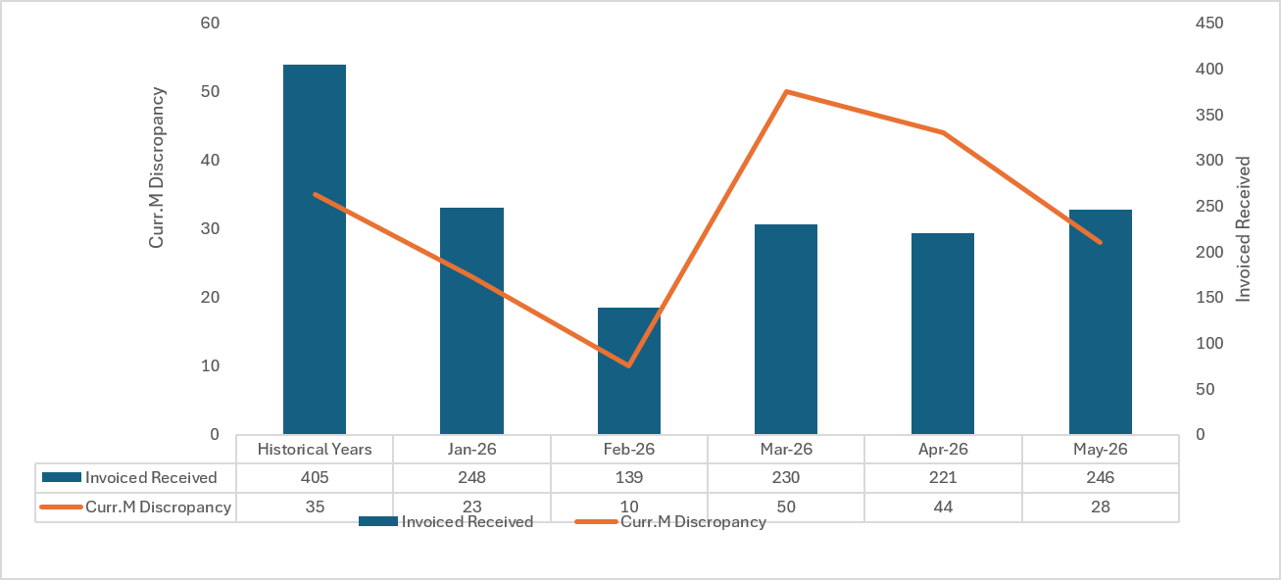
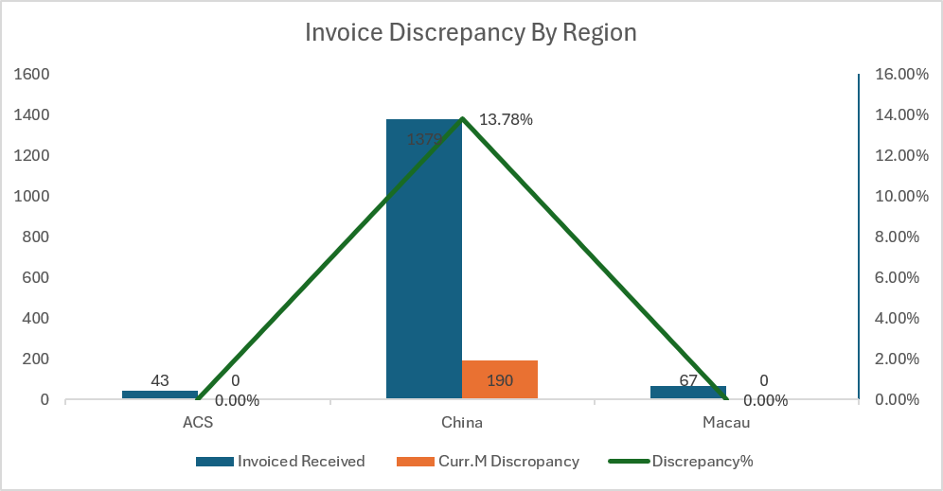
PROCURE-TO-PAY
Invoice Discrepancy Trend – Current Month
Reason | Mar. Count | Apr. Count | May.Count
GR shortage | 19 | 40 | 41
Insufficient supporting | 8 | 15 | 24
Invoice error | 1 | 5 | 10
Others | 8 | 1 | 10
PO error | 2 | 4 | 4
Total | 31 | 65 | 89

Slide 17
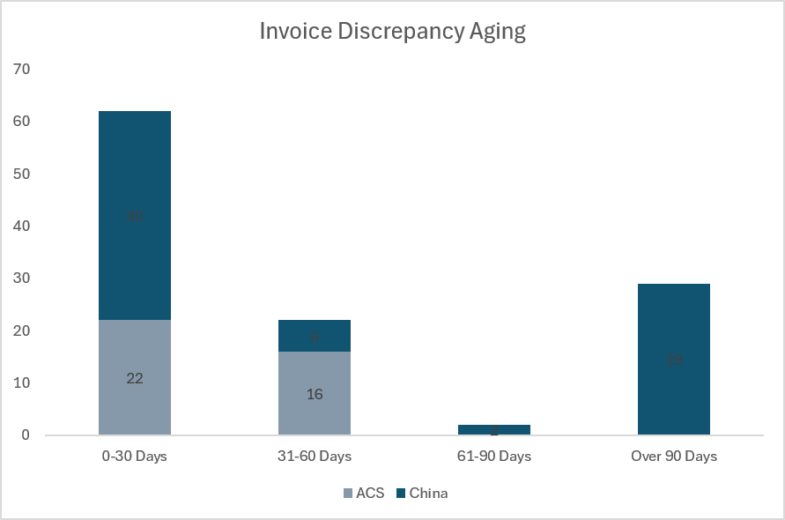
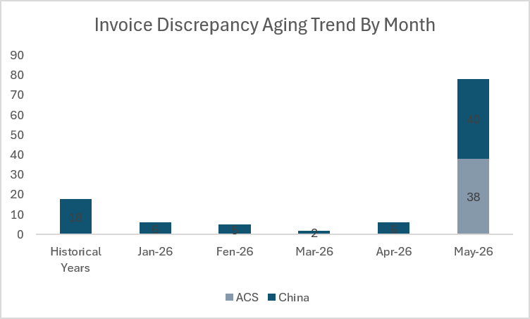
PROCURE-TO-PAY
Invoice Discrepancy - Open Items (as of May-26)
Aging over 60 days byType
Aging | China | ACS
61-90 Days | 2 | 0
Over 90 Days | 29 | 0
Aging over 60 days Details

Slide 18
PROCURE-TO-PAY
OP & OS Volume
<Comment>
As of May 31, the number of completed OP items stands at 834.
As of May 31, the OS volume stands at 540.
A total of 246 invoices were received in May. The peak volume occurred in Week 4 of May, reaching 70 invoices, accounting for 28.46% of the total.
Currently, there are 94 pending OP items and 21 pending OS items, totaling 115 open items, among which 62 items were turned back.

Slide 19
PROCURE-TO-PAY
T&E Volume Processing

Slide 20
PROCURE-TO-PAY
T&E Discrepancy Reason
BU | Insufficient supporting | Mistake Submission | Exceed limit | Overdue expenses | Claim without approval | Incorrect invoice | Total
CN | 35 | 15 | 3 | 4 | 6 | 3 | 66
HK | 14 | 14 | 1 | 0 | 3 | 0 | 32
MO | 0 | 0 | 0 | 0 | 0 | 0 | 0
Total | 49 | 29 | 4 | 4 | 9 | 3 | 98

Slide 21
ORDER TO CASH

Slide 22
ORDER TO CASH
OTC09 & OTC10

Slide 23
APPENDIX

Slide 24
SLA’S / KPI’S

